Slide 1
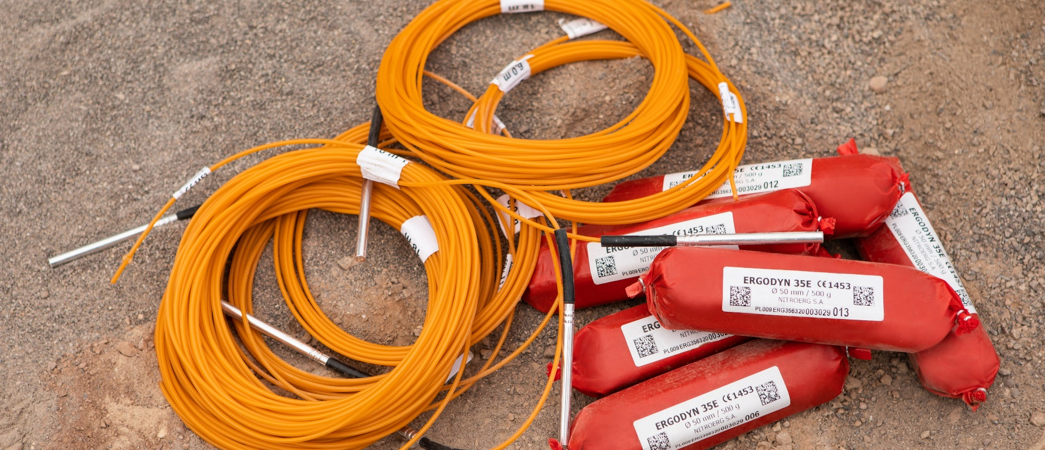
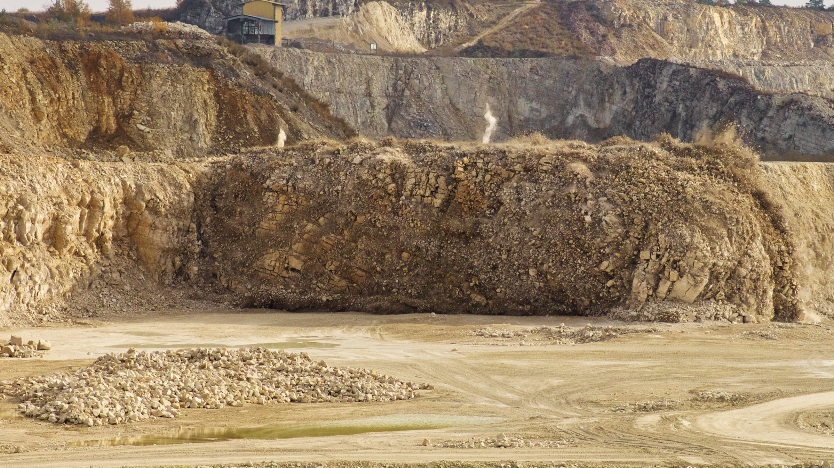
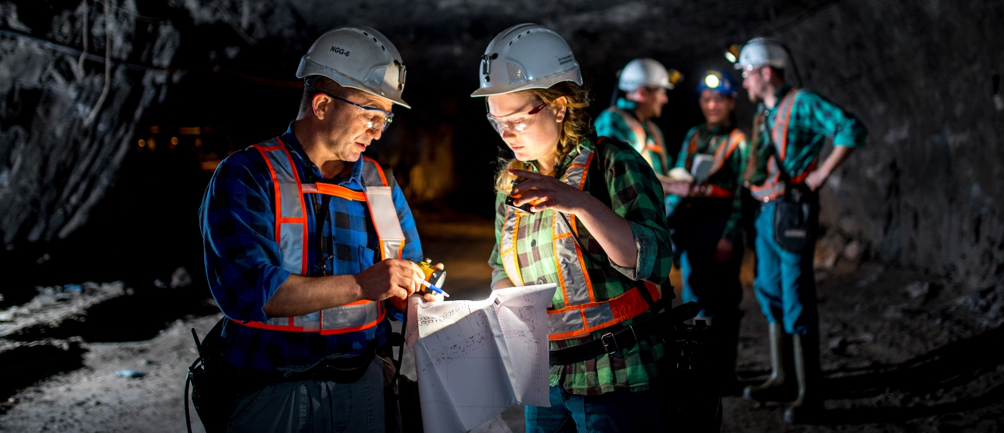

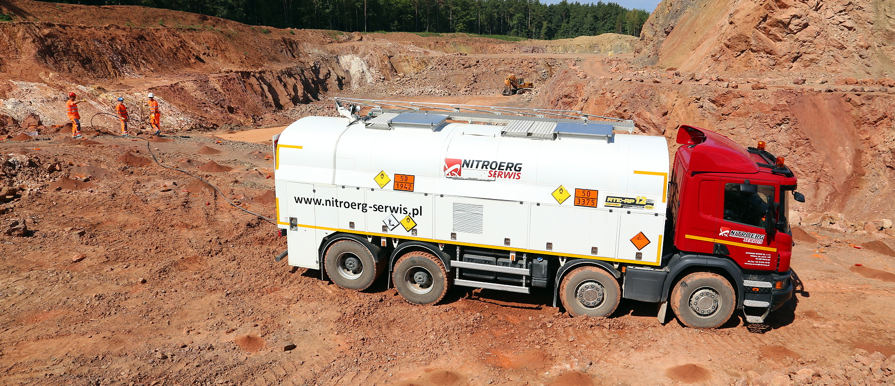
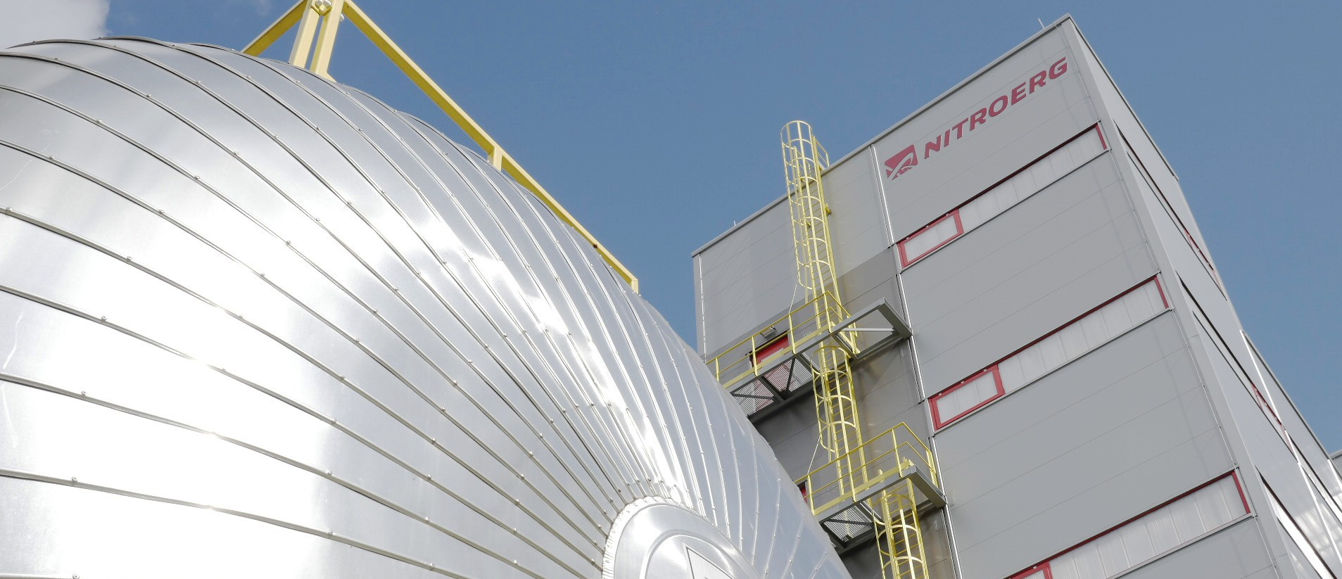
PRESENTATION OF
NITROERG S.A.
We are the largest manufacturer of explosives and initiating systems for civilian use in Poland and one of the largest in Europe. We also produce highly valued diesel fuel additives.
With 150 years of experience and continuous development, we are a reliable business partner with customers on six continents.

Slide 2
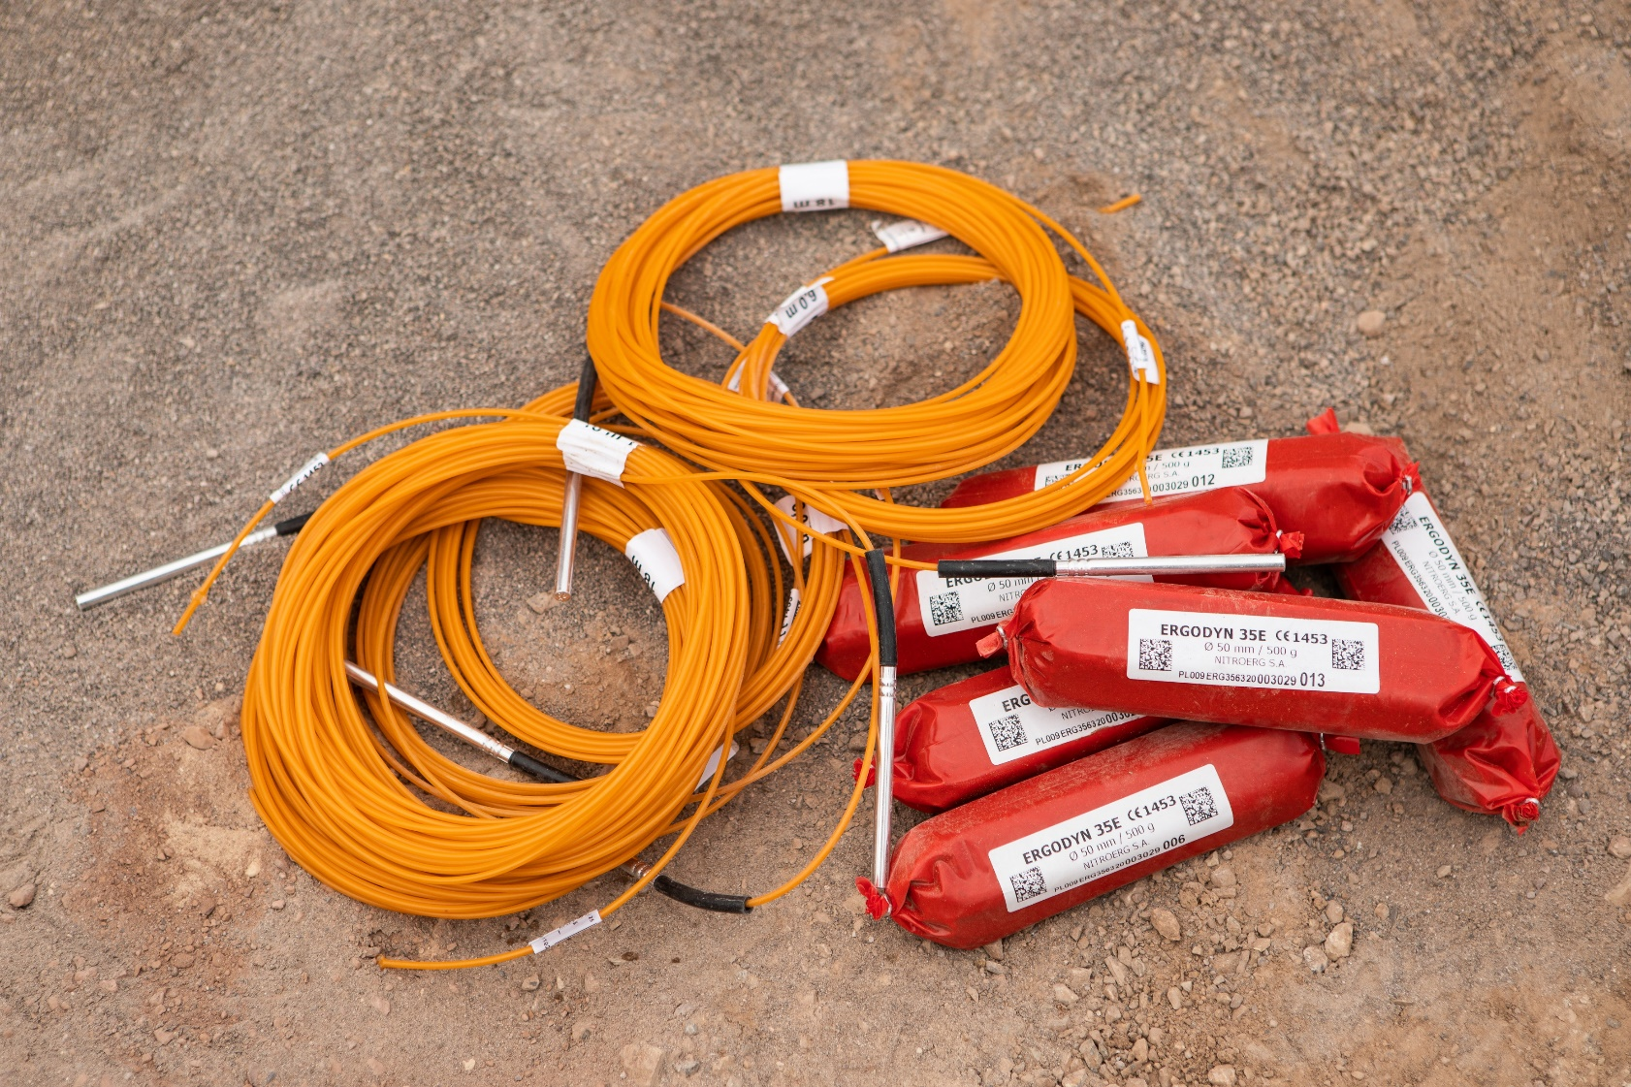
PRESENTATION OF
NITROERG S.A.
We are the largest manufacturer of explosives and initiating systems for civilian use in Poland and one of the largest in Europe. We also produce highly valued diesel fuel additives.
With over 150 years of experience and continuous development, we are a reliable business partner with customers on six continents.

Slide 3
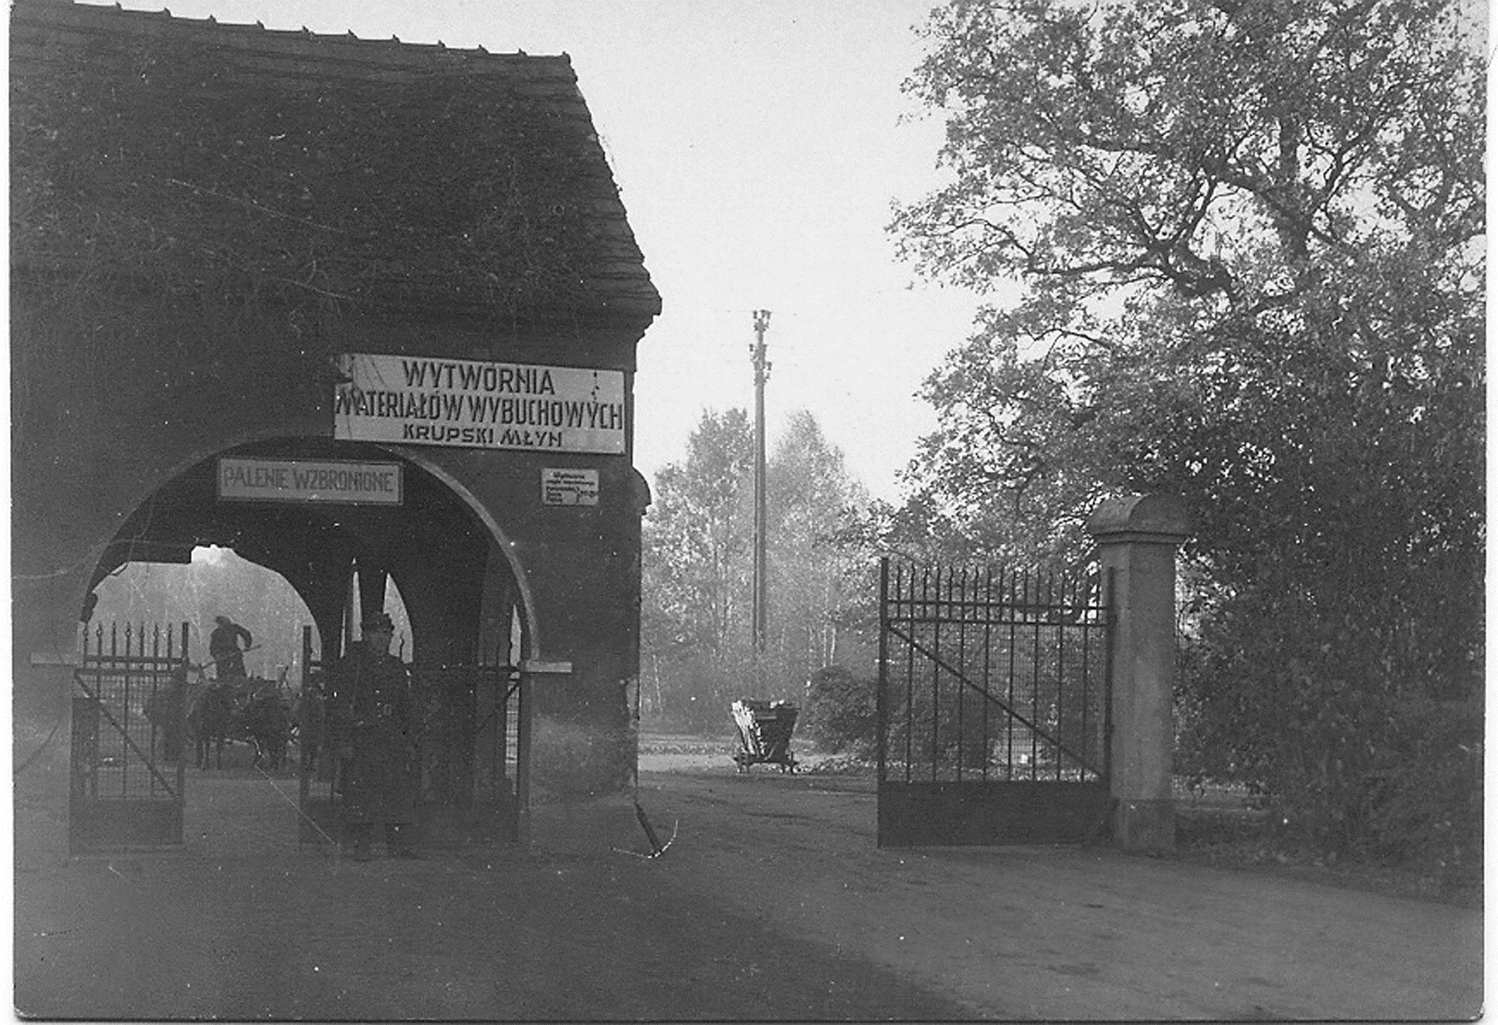

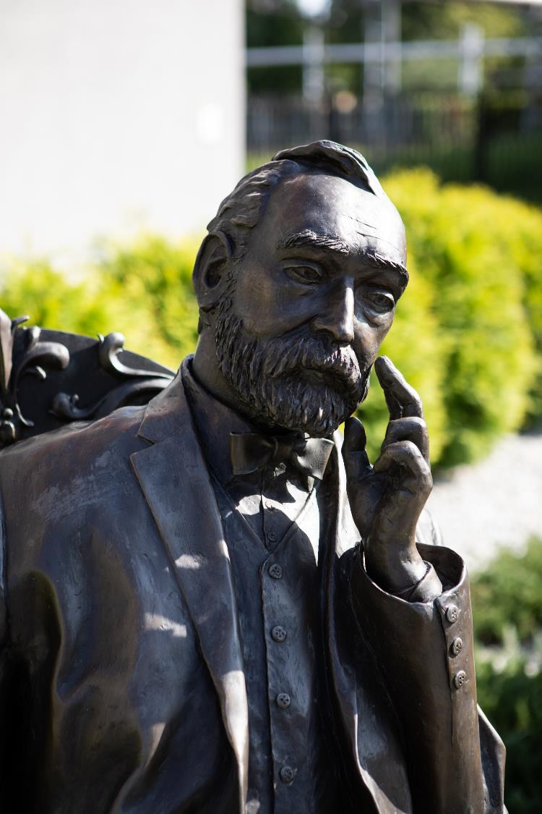
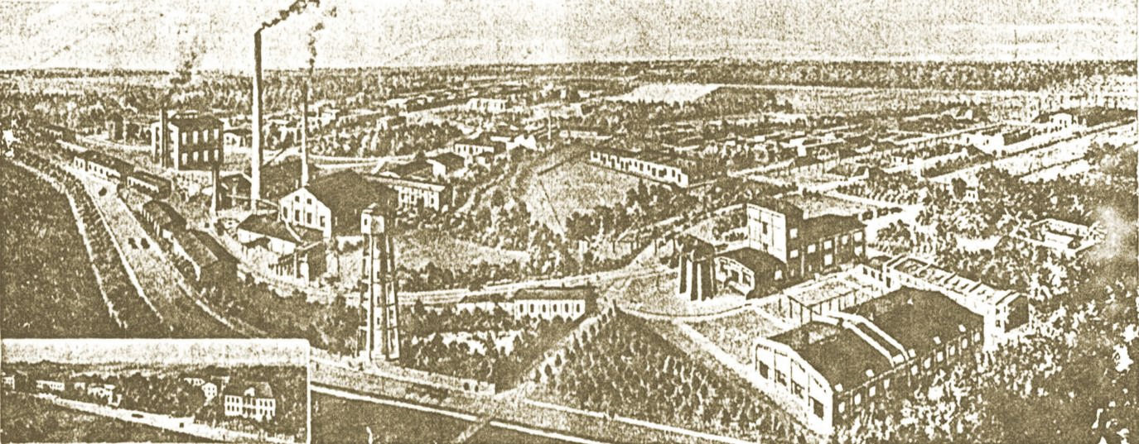
TRADITION
A few years after Alfred Nobel invented dynamite, two independent factories producing explosives were established in Bieruń and Krupski Młyn. Currently they operate as one company – NITROERG S.A.
We are the largest manufacturer of explosives and initiating systems for civilian use in Poland and one of the largest in Europe. We also produce highly valued diesel fuel additives.
With 150 years of experience and continuous development, we are a reliable business partner with customers on six continents.

Slide 4
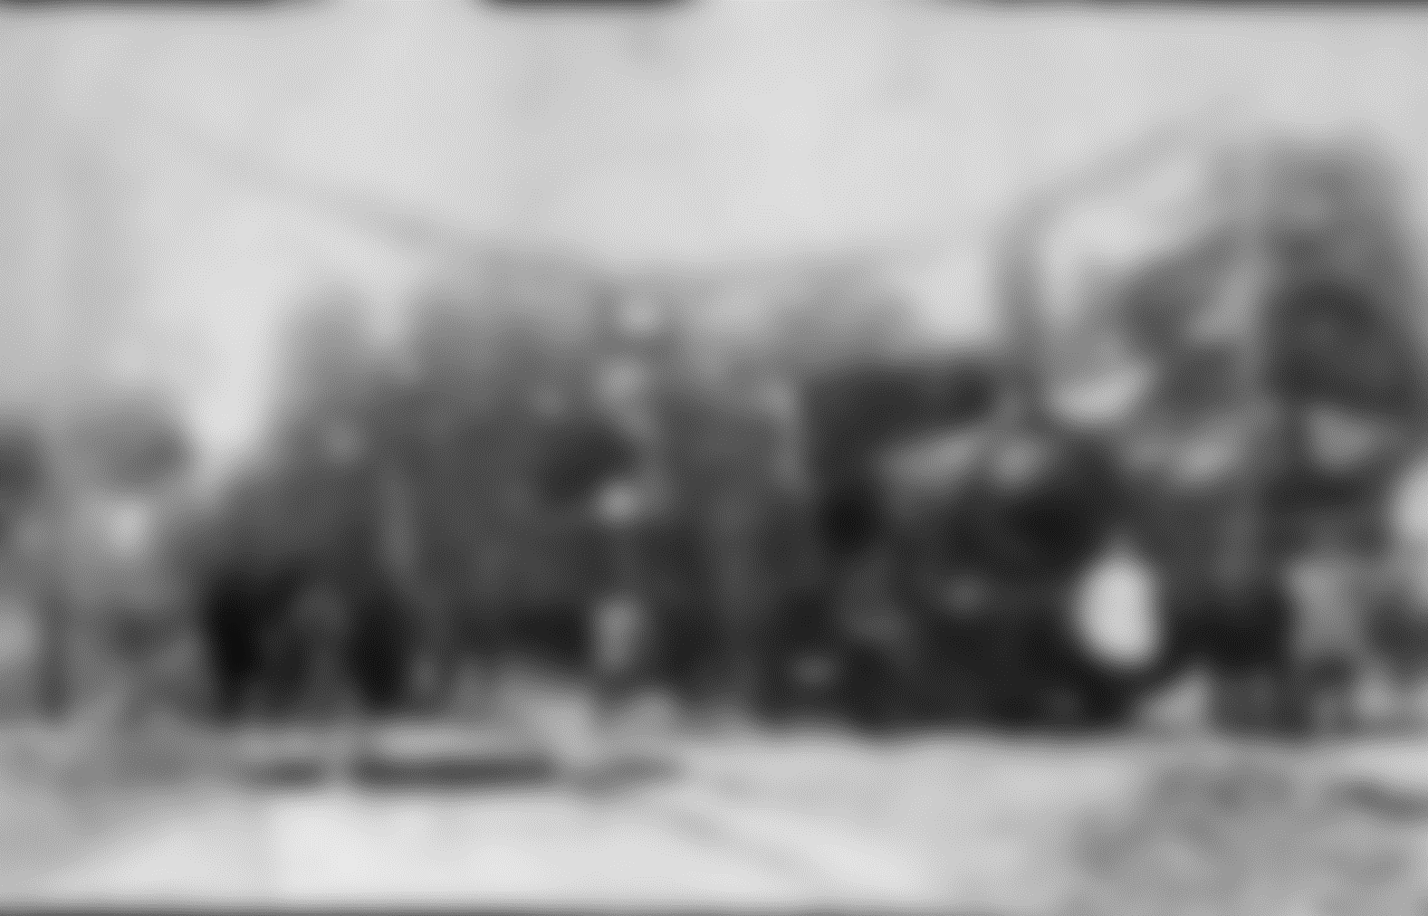
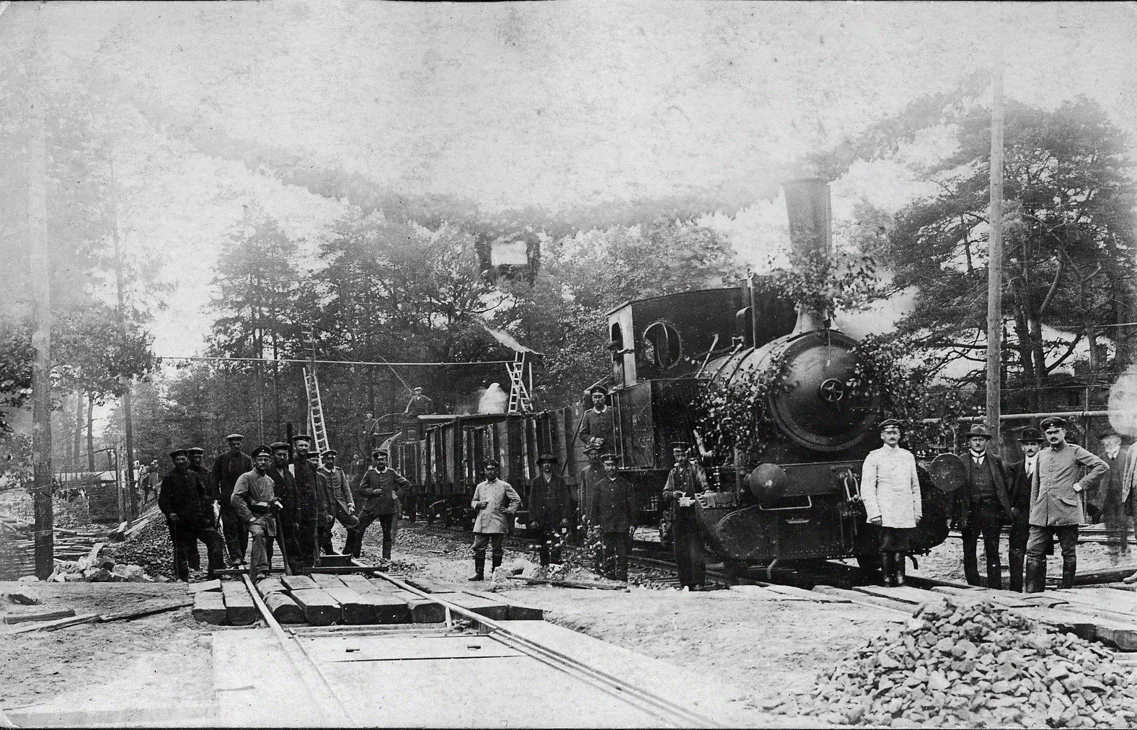
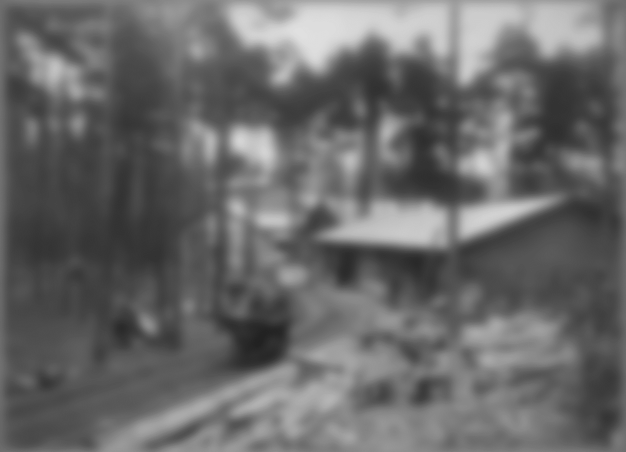
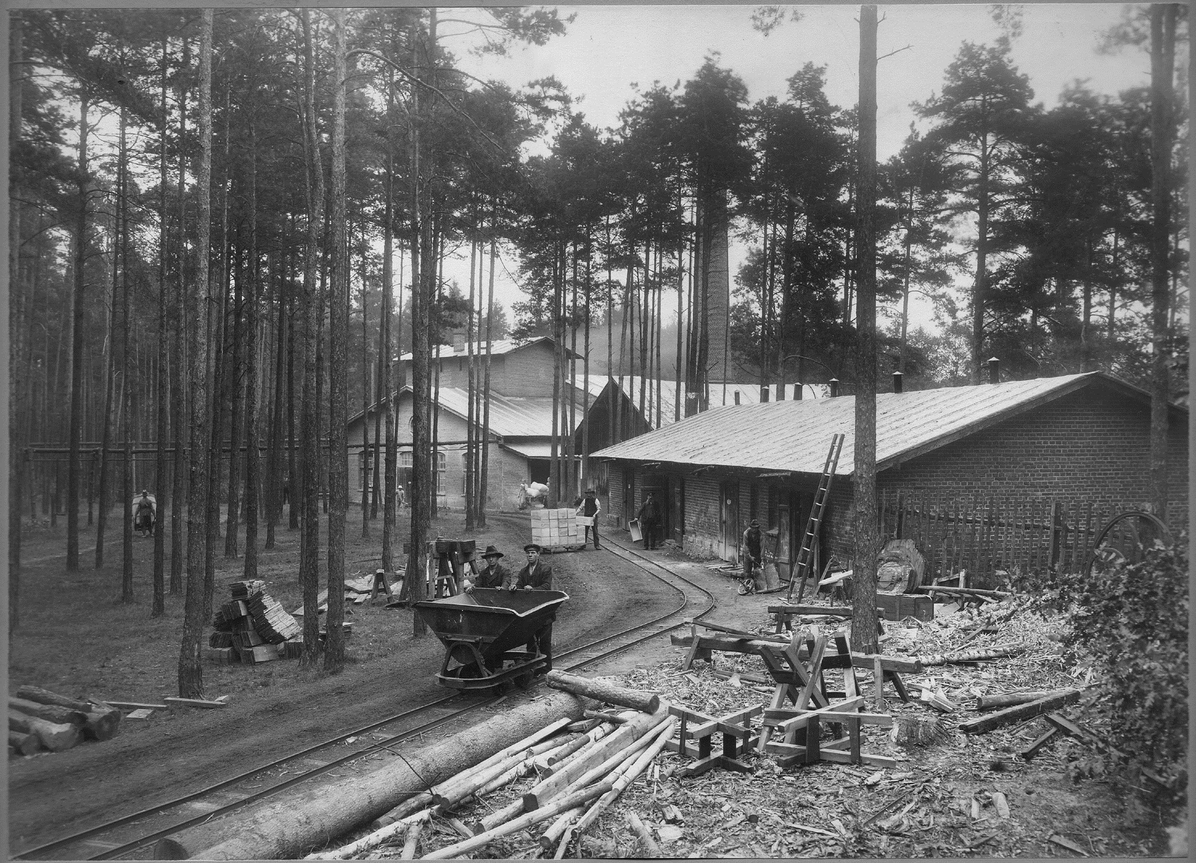

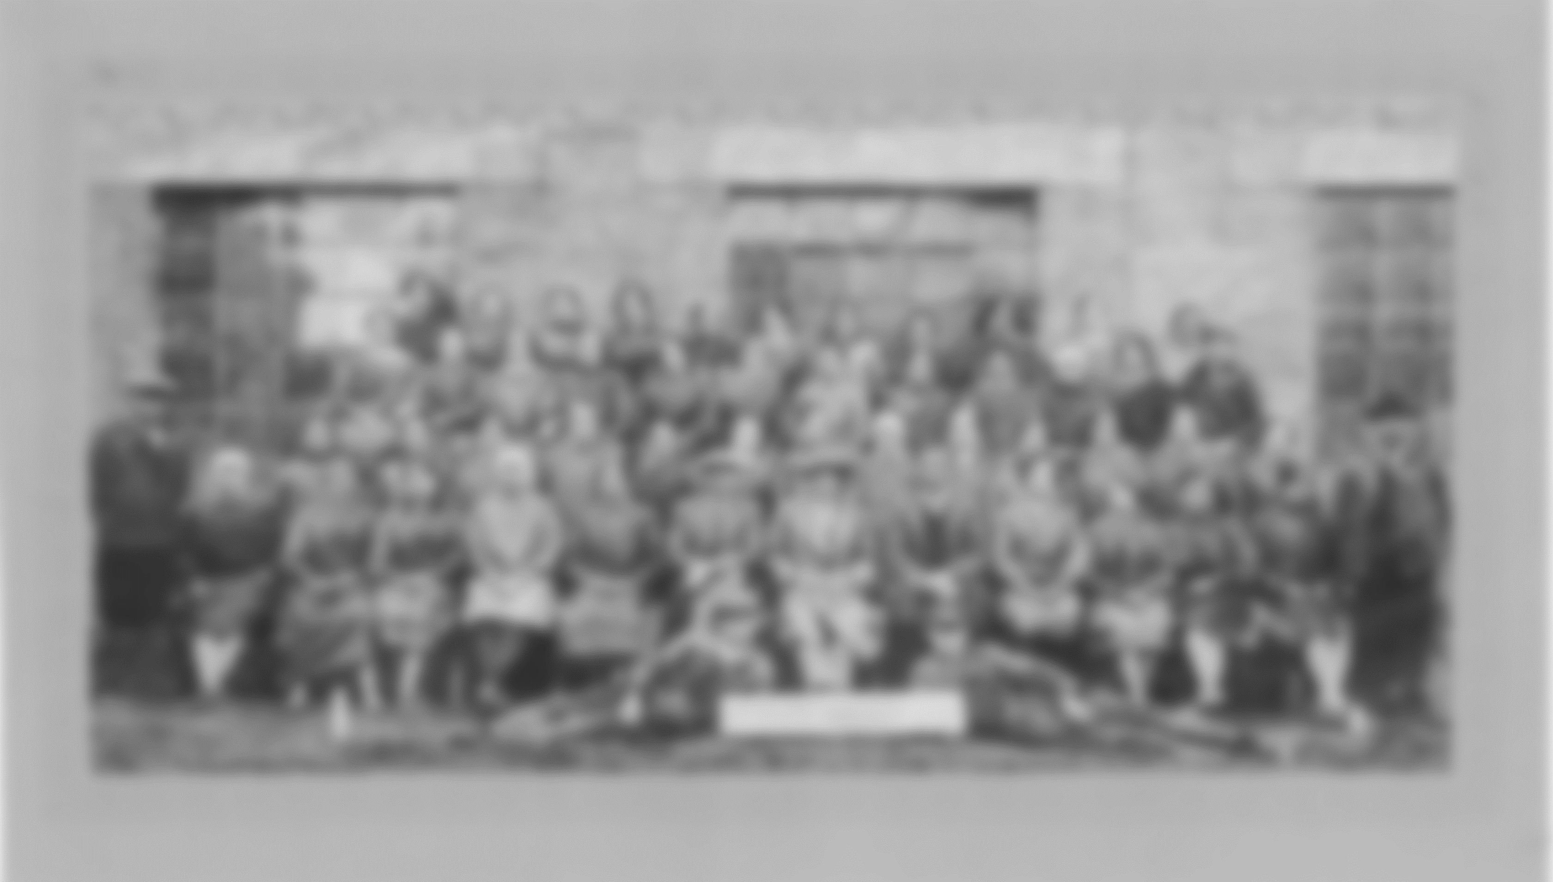





TRADITION
A few years after Alfred Nobel invented dynamite, two independent factories producing explosives were established in Bieruń and Krupski Młyn. Currently they operate as one company – NITROERG S.A.
8th
1871
4 years after
the invention
of dynamite
Continuously in operation for
Establishment of an explosives factory
150 years
dynamite factory in the world

Slide 5

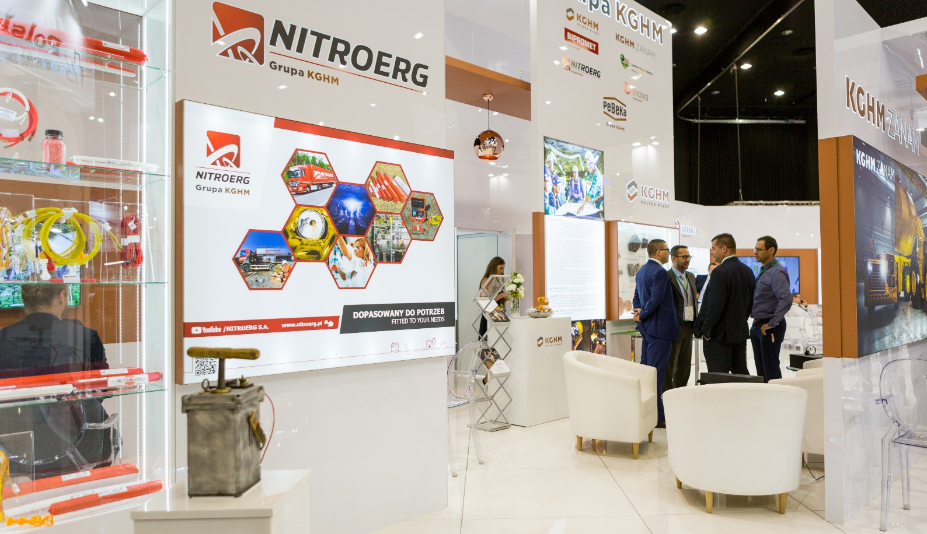




TRADITION
ORGANIZATION
Since 2011, our main shareholder is KGHM Polska Miedź S.A. – a global leader in the production of silver and copper, which operates on three continents: in Europe, North America and South America.
8th
1871
4 years after
the invention
of dynamite
Continuously in operation for
Establishment of an explosives factory
150 years
dynamite factory in the world

Slide 6
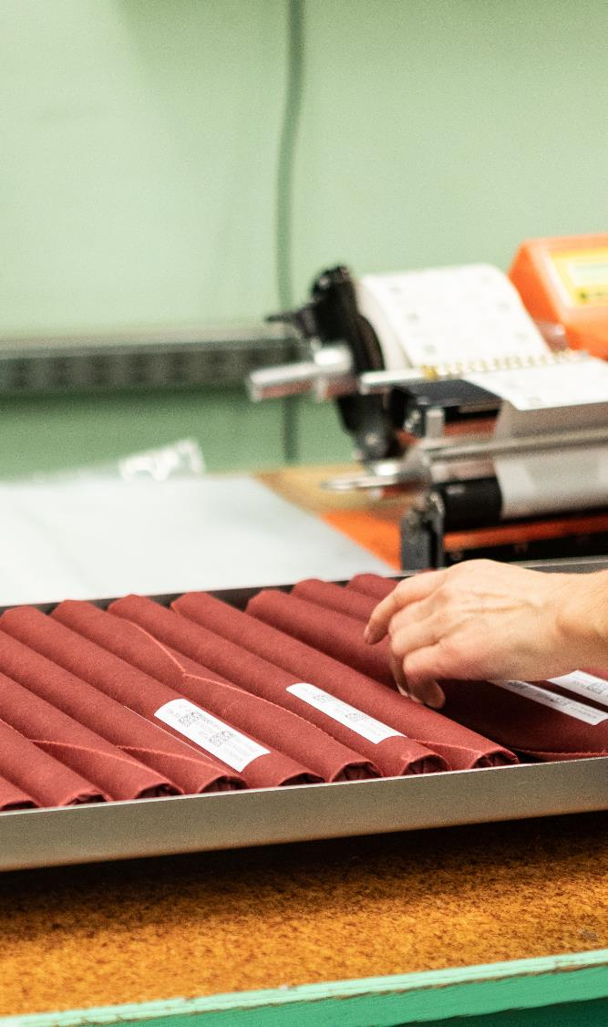

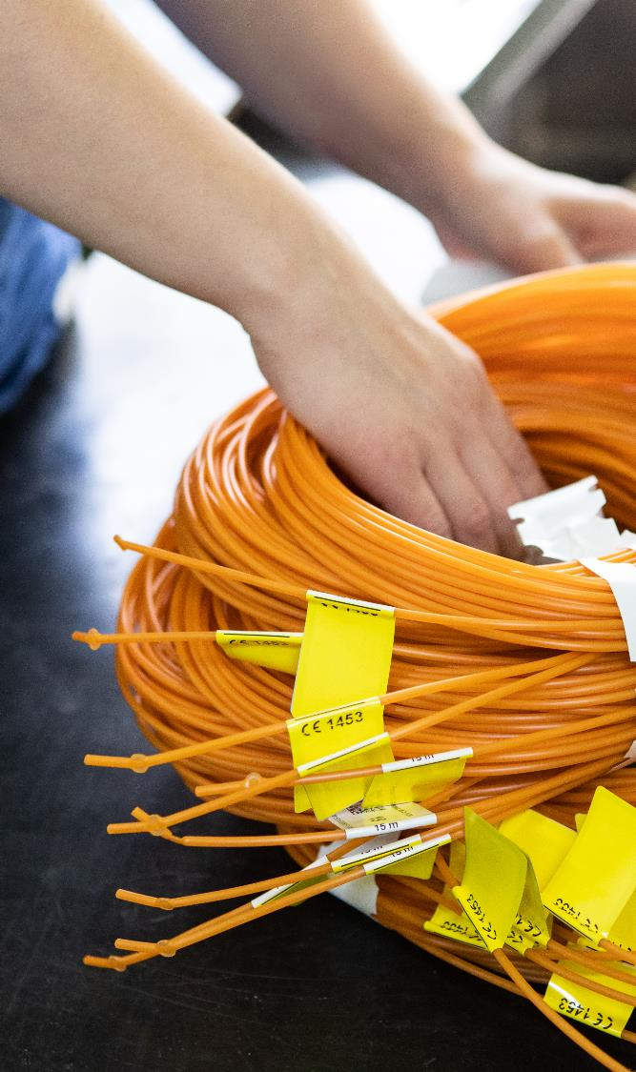










ORGANIZATION
POTENCJAŁ
PRODUCTS
SŁAWOMIR KWIATKOWSKI
GRZEGORZ SOSNA
TOMASZ MALISZEWSKI
MEMBER OF THE BOARD
Production and Commercial Director
PRESIDENT OF THE BOARD
General Director
MEMBER OF THE BOARD
Financial Director
EXPLOSIVES
INITIATING SYSTEMS
DIESEL FUEL
ADDITIVES
Sales
Customer service
Manufacture of explosives and blasting agents
Production of NITROCET
Technology
Quality and environmental management
Safety and administration
OHS
Investments and maintenance
Human resources
Marketing and strategic analysis
Research and development
Organization and promotion
Finance and accounting
Controlling and financial analyses
Purchasing
Logistics
IT
NASZE MOŻLIWOŚCI PRODUKCYJNE

Slide 7
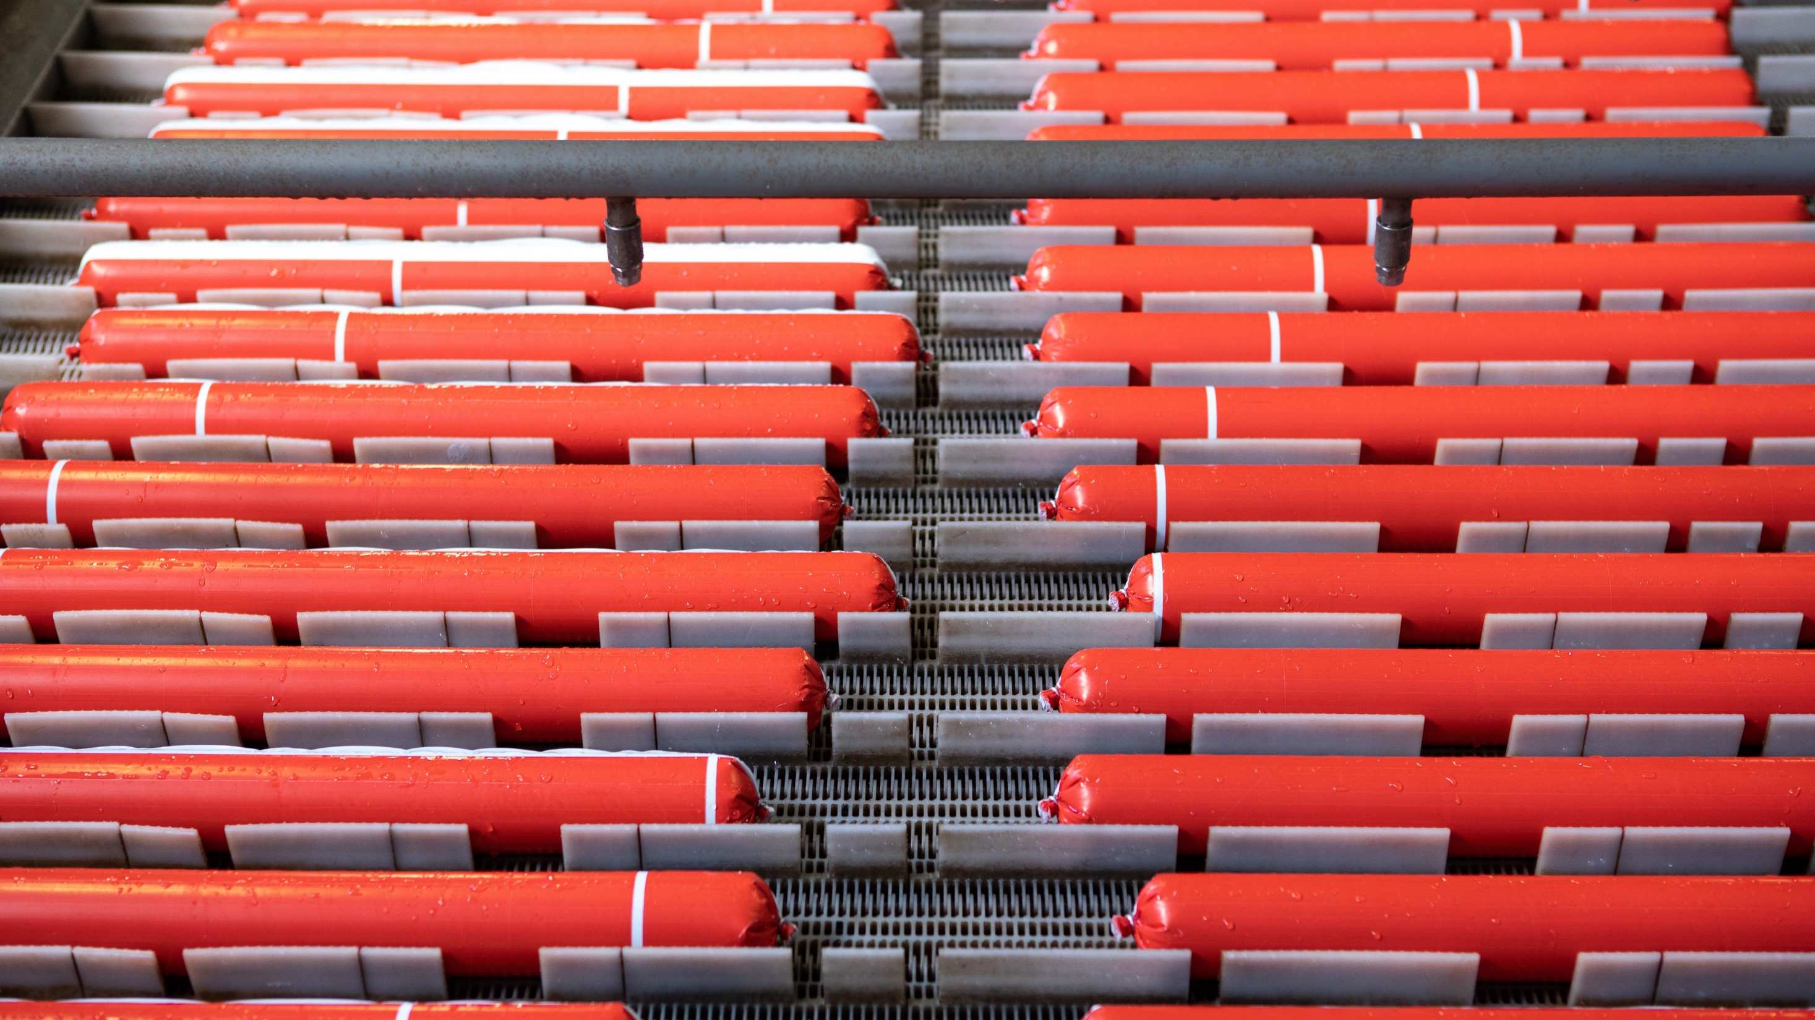
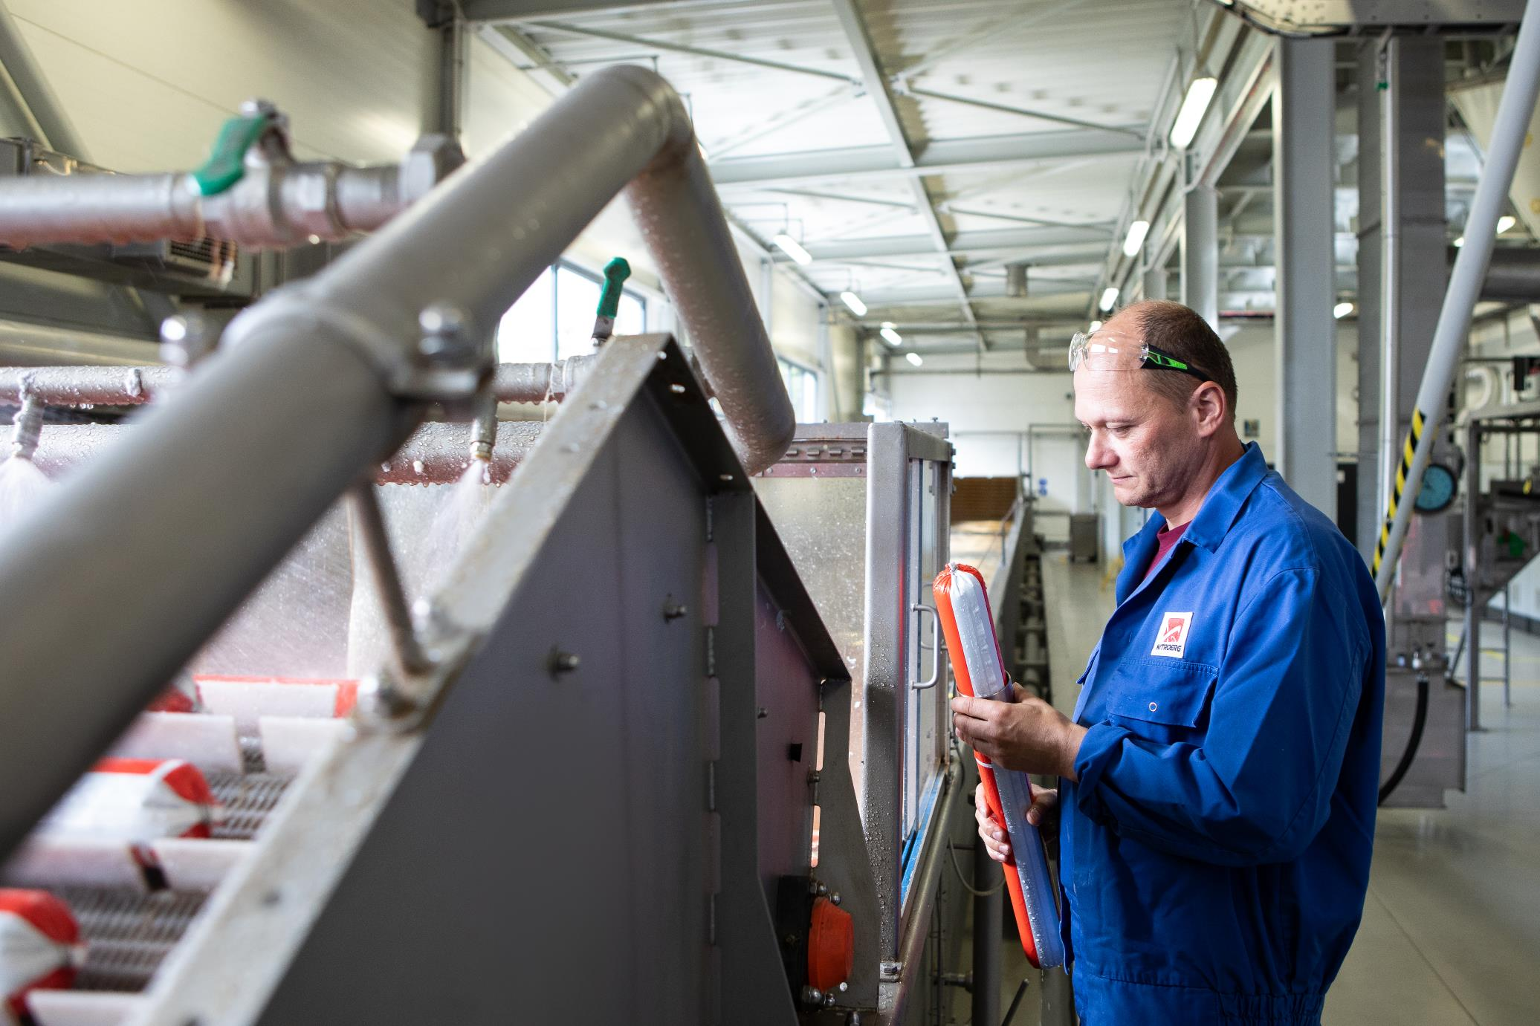




PRODUCTS
EXPLOSIVES
BROAD RANGE
of explosives for different operating conditions
WIDE SELECTION
of offered diameters and weights of cartridged explosives adapted to customers' requirements
PRODUCTION TECHNOLOGIES
We offer a wide range of explosives, designed for blasting works in underground and opencast mining, as well as in engineering works.
EXPLOSIVES
ensuring the adaptation of products to customer needs (cartridged, packaged materials, different sensitization techniques, possibility of mechanical loading)
INITIATING SYSTEMS
EXPLOSIVES
DIESEL FUEL
ADDITIVES

Slide 8
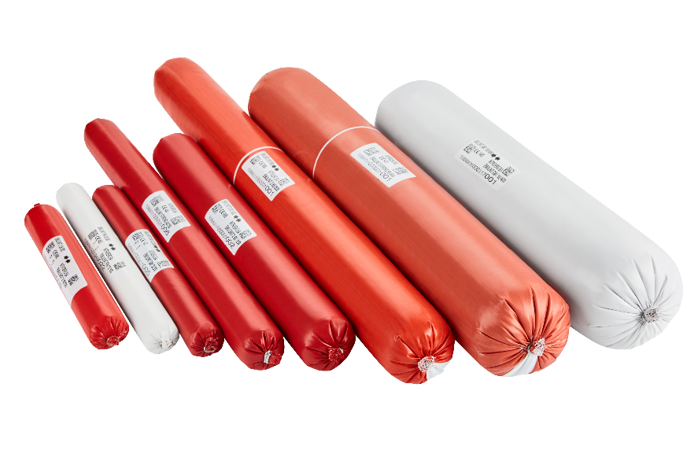


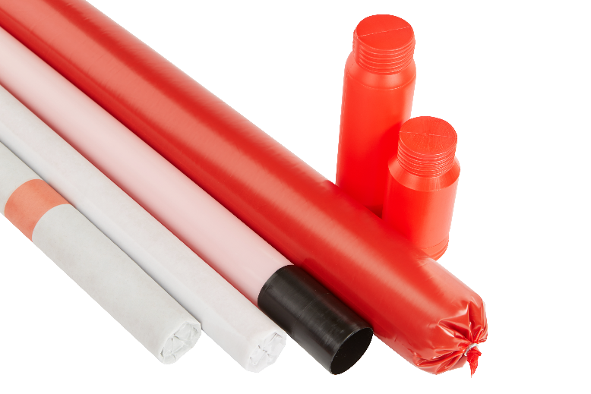


EXPLOSIVES
BROAD RANGE
of explosives for different operating conditions
WIDE SELECTION
of offered diameters and weights of cartridged explosives adapted to customers' requirements
PRODUCTION TECHNOLOGIES
We offer a wide range of explosives, designed for blasting works in underground and opencast mining, as well as in engineering works.
EXPLOSIVES
ensuring the adaptation of products to customer needs (cartridged, packaged materials, different sensitization techniques, possibility of mechanical loading)
Designed for use in places where there is no risk of methane or coal dust explosion.
dynamites: ERGODYN, POLADYN
emulsion (cartridged and bulk): EMULINIT
Designed for use in places where there is risk of methane or coal dust explosion
emulsion: EMULINIT PM

Slide 9




EXPLOSIVES
BROAD RANGE
of explosives for different operating conditions
WIDE SELECTION
Designed for use in places where there is no risk of methane or coal dust explosion.
dynamites: ERGODYN, POLADYN
emulsion (cartridged and bulk): EMULINIT
of offered diameters and weights of cartridged explosives adapted to customers' requirements
PRODUCTION TECHNOLOGIES
Designed for use in places where there is risk of methane or coal dust explosion
emulsion: EMULINIT PM
We offer a wide range of explosives, designed for blasting works in underground and opencast mining, as well as in engineering works.
ensuring the adaptation of products to customer needs (cartridged, packaged materials, different sensitization techniques, possibility of mechanical loading)

Slide 10

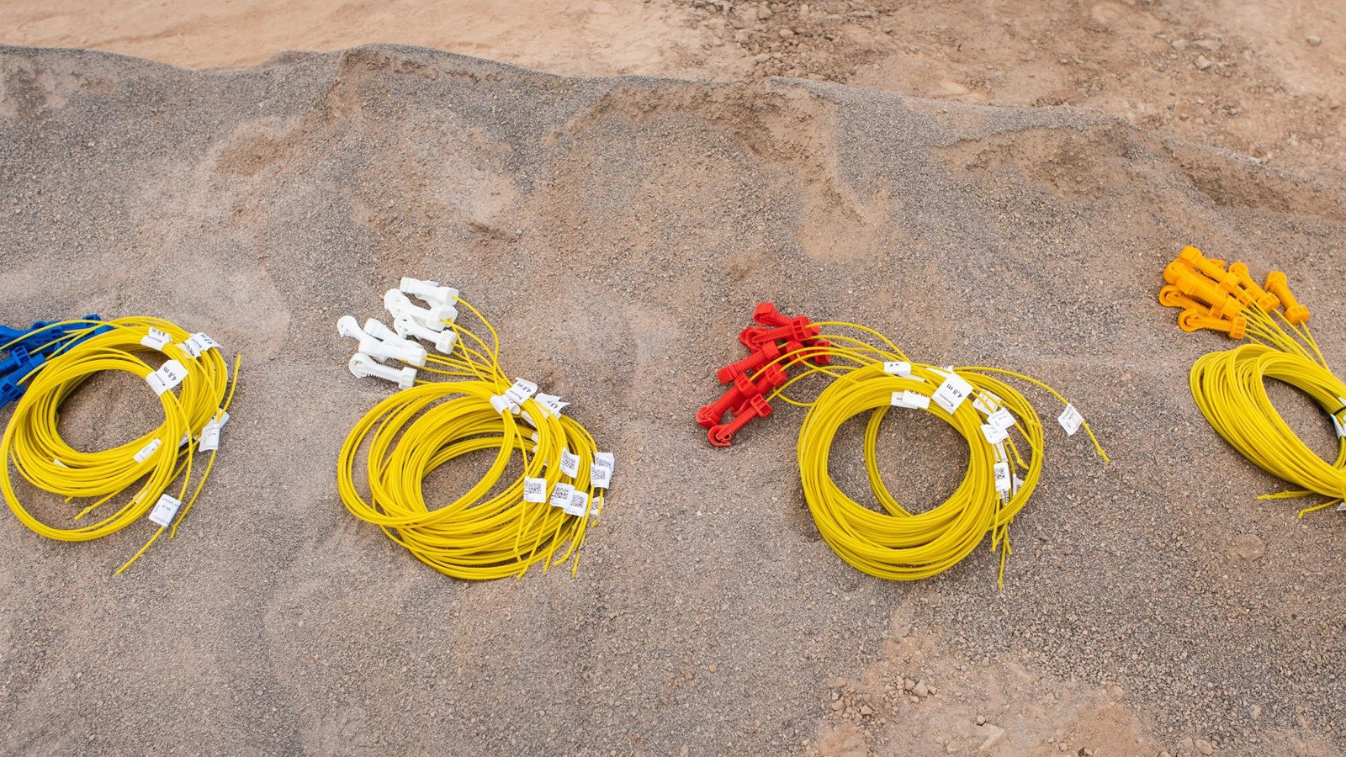
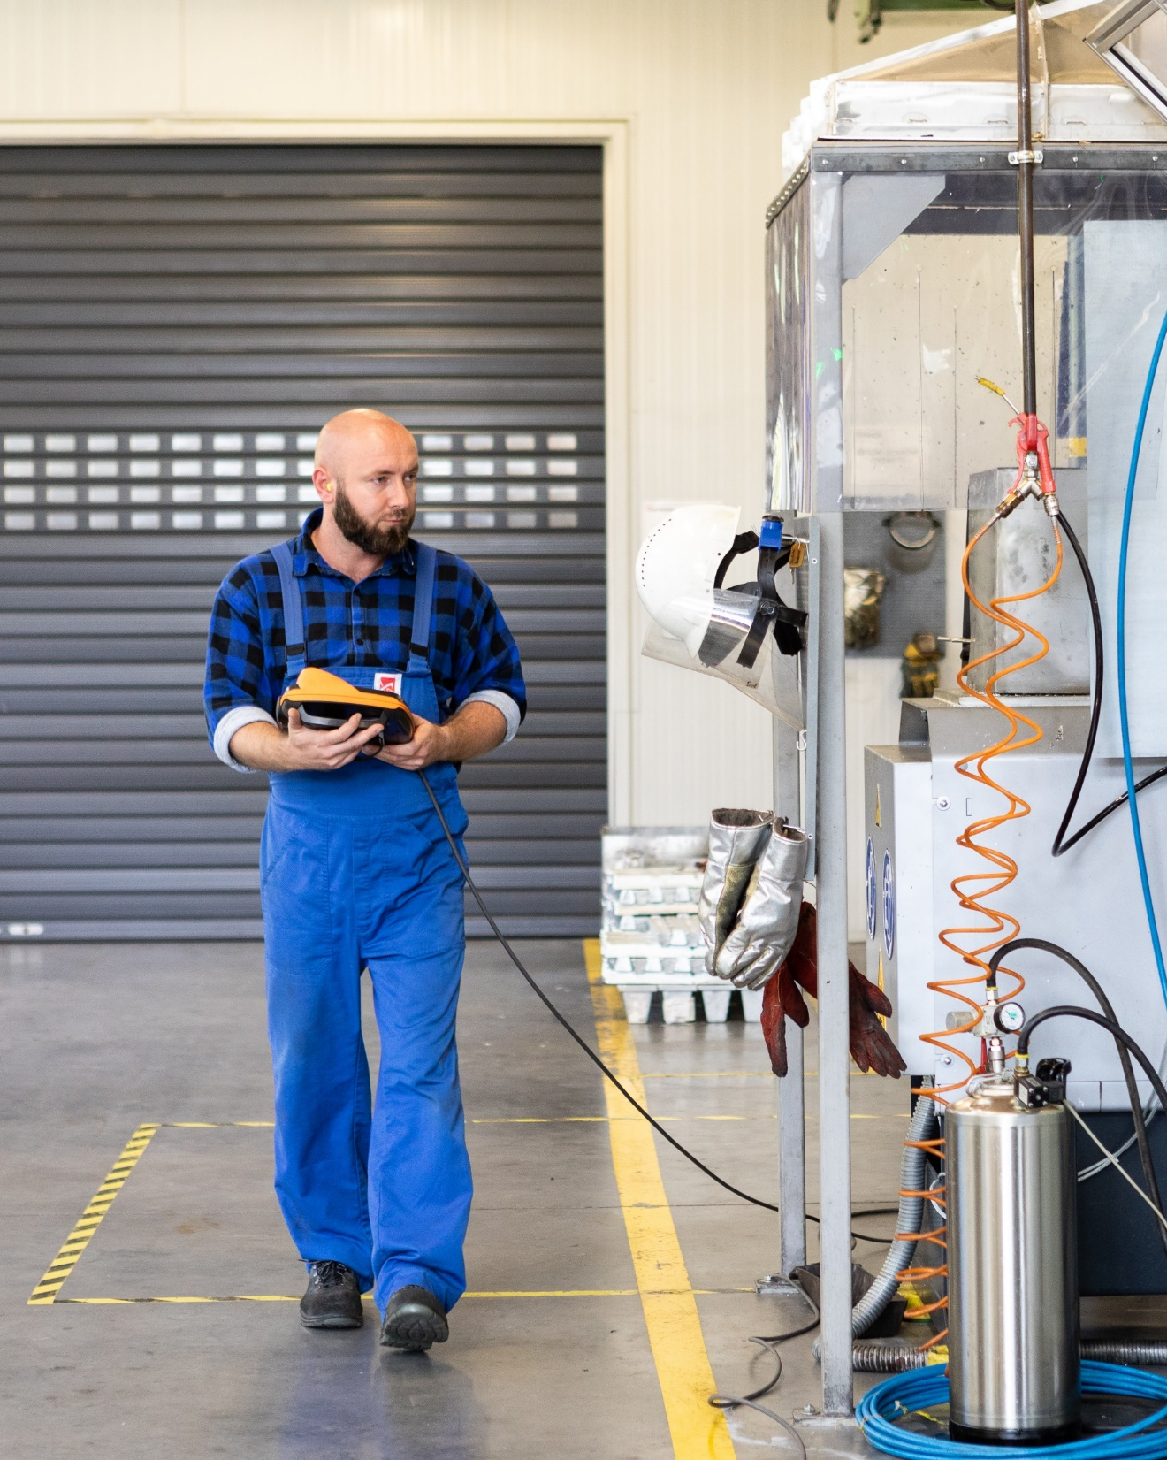
EXPLOSIVES
INITIATING SYSTEMS
BROAD RANGE
of initiating systems for various conditions and applications, including reinforced, pressure and heat resistant
WIDE SELECTION
of detonator types offered: electric, non-electric and electronic, tailored to customer requirements
INITIATING
SYSTEMS
PRODUCTION TECHNOLOGIES
Our offer includes a wide range of initiating systems, designed for blasting works in underground and opencast mining, as well as in engineering works.
providing the possibility of production adapted to the needs of customers, products available in different transport classes (1.1 B, 1.4 B, 1.4 S)
Designed for use in places where there is no risk of methane or coal dust explosion.
dynamites: ERGODYN, POLADYN
emulsion (cartridged and bulk): EMULINIT
Designed for use in places where there is risk of methane or coal dust explosion
emulsion: EMULINIT PM

Slide 11

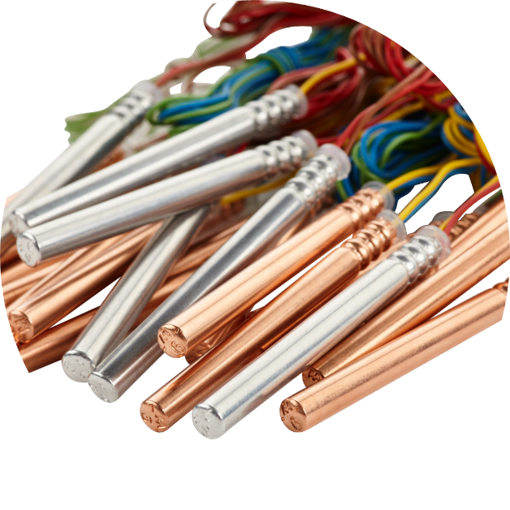
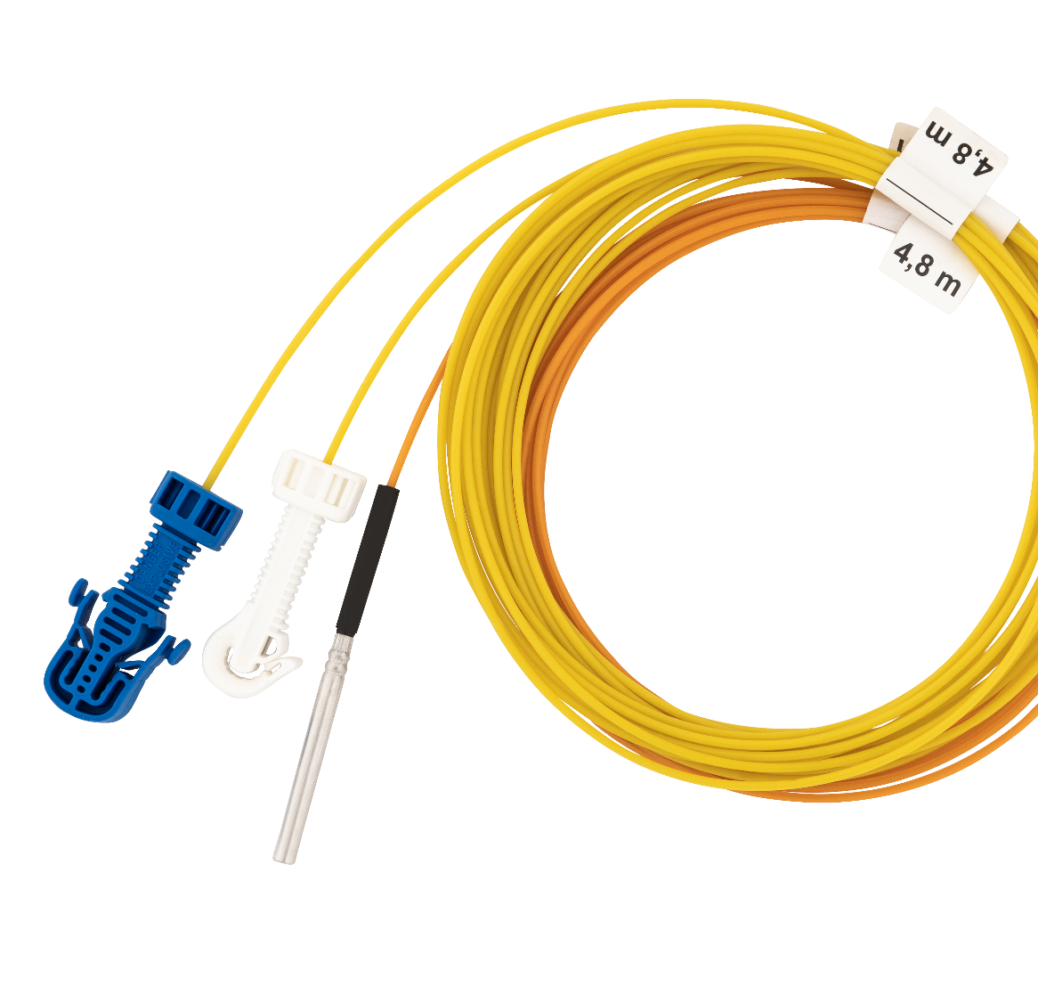
INITIATING SYSTEMS
ERGODET electric detonators
BROAD RANGE
ERGODET rock detonators
ERGODET W safe against coal dust
ERGODET M safe against methane and coal dust
of initiating systems for various conditions and applications, including reinforced, pressure and heat resistant
WIDE SELECTION
of detonator types offered: electric, non-electric and electronic, tailored to customer requirements
NITRONEL® non-electric detonators
INITIATING
SYSTEMS
PRODUCTION TECHNOLOGIES
NITRONEL MS, NITRONEL LP (for use in tunneling works and for rock-cutting in open-pit mines and in underground non-coal mines)
surface NITRONEL QS and borehole NITRONEL QH (for use in open-pit mines)
providing the possibility of production adapted to the needs of customers, products available in different transport classes (1.1 B, 1.4 B, 1.4 S)
Our offer includes a wide range of initiating systems, designed for blasting works in underground and opencast mining, as well as in engineering works.

Slide 12
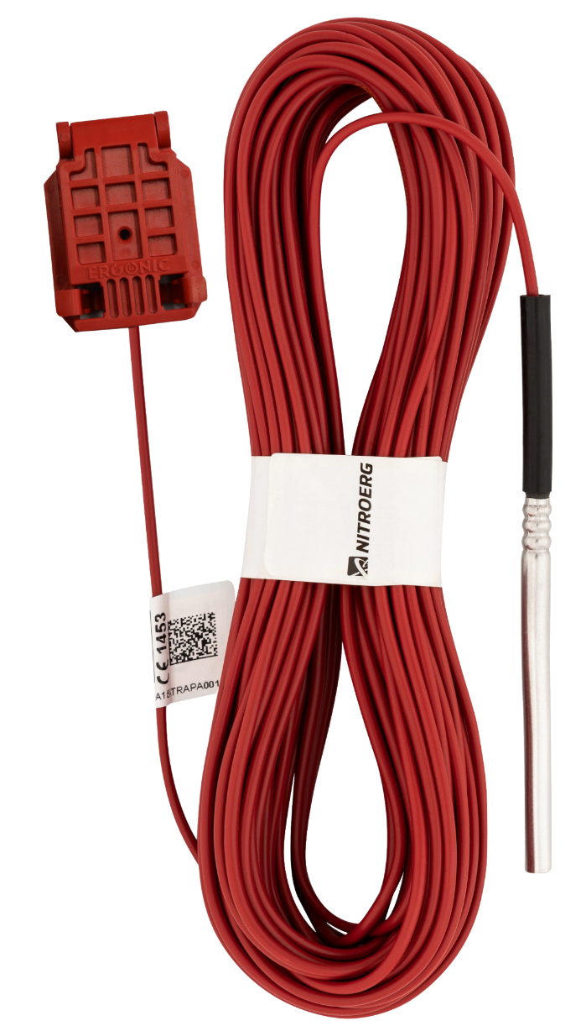
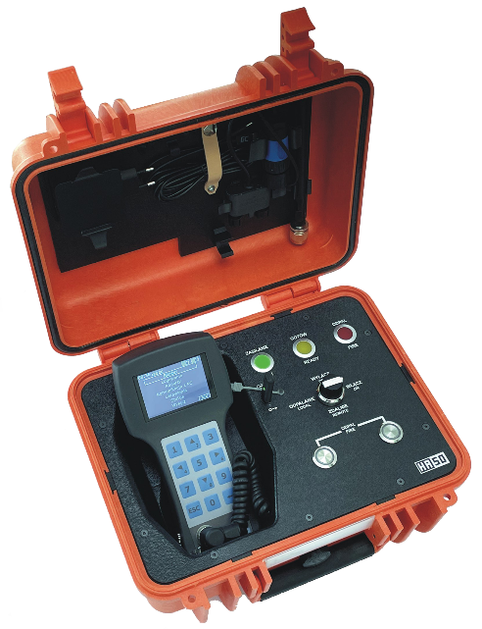
NOVELTY
INITIATING SYSTEMS
ERGODET electric detonators
BROAD RANGE
of initiating systems for various conditions and applications, including reinforced, pressure and heat resistant
ERGODET rock detonators
ERGODET W safe against coal dust
ERGODET M safe against methane and coal dust
WIDE SELECTION
of detonator types offered: electric, non-electric and electronic, tailored to customer requirements
NITRONEL® non-electric detonators
PRODUCTION TECHNOLOGIES
NITRONEL MS, NITRONEL LP (for use in tunneling works and for rock-cutting in open-pit mines and in underground non-coal mines)
surface NITRONEL QS and borehole NITRONEL QH (for use in open-pit mines)
Our offer includes a wide range of initiating systems, designed for blasting works in underground and opencast mining, as well as in engineering works.
providing the possibility of production adapted to the needs of customers, products available in different transport classes (1.1 B, 1.4 B, 1.4 S)
ERGONIC-II electronic initiating system
programmable delays in the range of 0-20000 ms with an interval of 1 ms
ability to program and detonate up to 1,000 detonators per logger/blaster
possibility to combine logger/blaster sets in order to increase the number of set-off detonators
remote (wireless) ignition of detonators

Slide 13
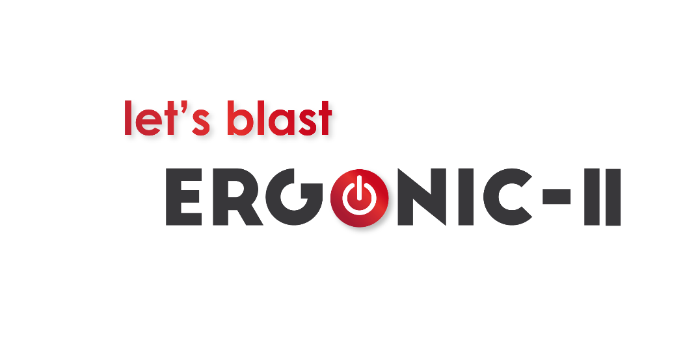
OTHER PRODUCTS
INITIATING SYSTEMS
NOVELTY
ERGONIC-II electronic initiating system
programmable delays in the range of 0-20000 ms with an interval of 1 ms
ability to program and detonate up to 1,000 detonators per logger/blaster
possibility to combine logger/blaster sets in order to increase the number of set-off detonators
remote (wireless) ignition of detonators
ERGODET electric detonators
ERGODET rock detonators
ERGODET W safe against coal dust
ERGODET M safe against methane and coal dust
NITRONEL® non-electric detonators
NITRONEL MS, NITRONEL LP (for use in tunneling works and for rock-cutting in open-pit mines and in underground non-coal mines)
surface NITRONEL QS and borehole NITRONEL QH (for use in open-pit mines)

Slide 14
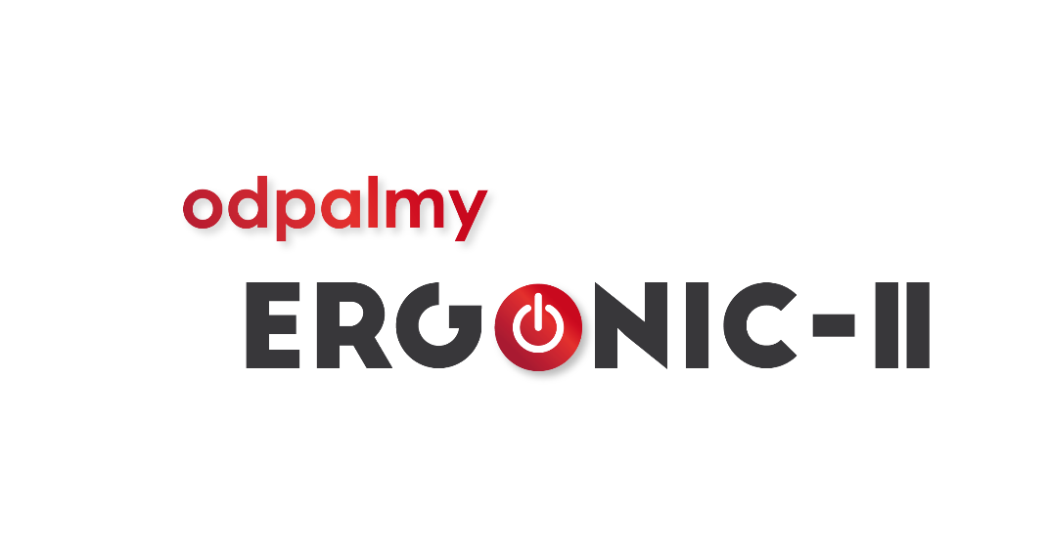
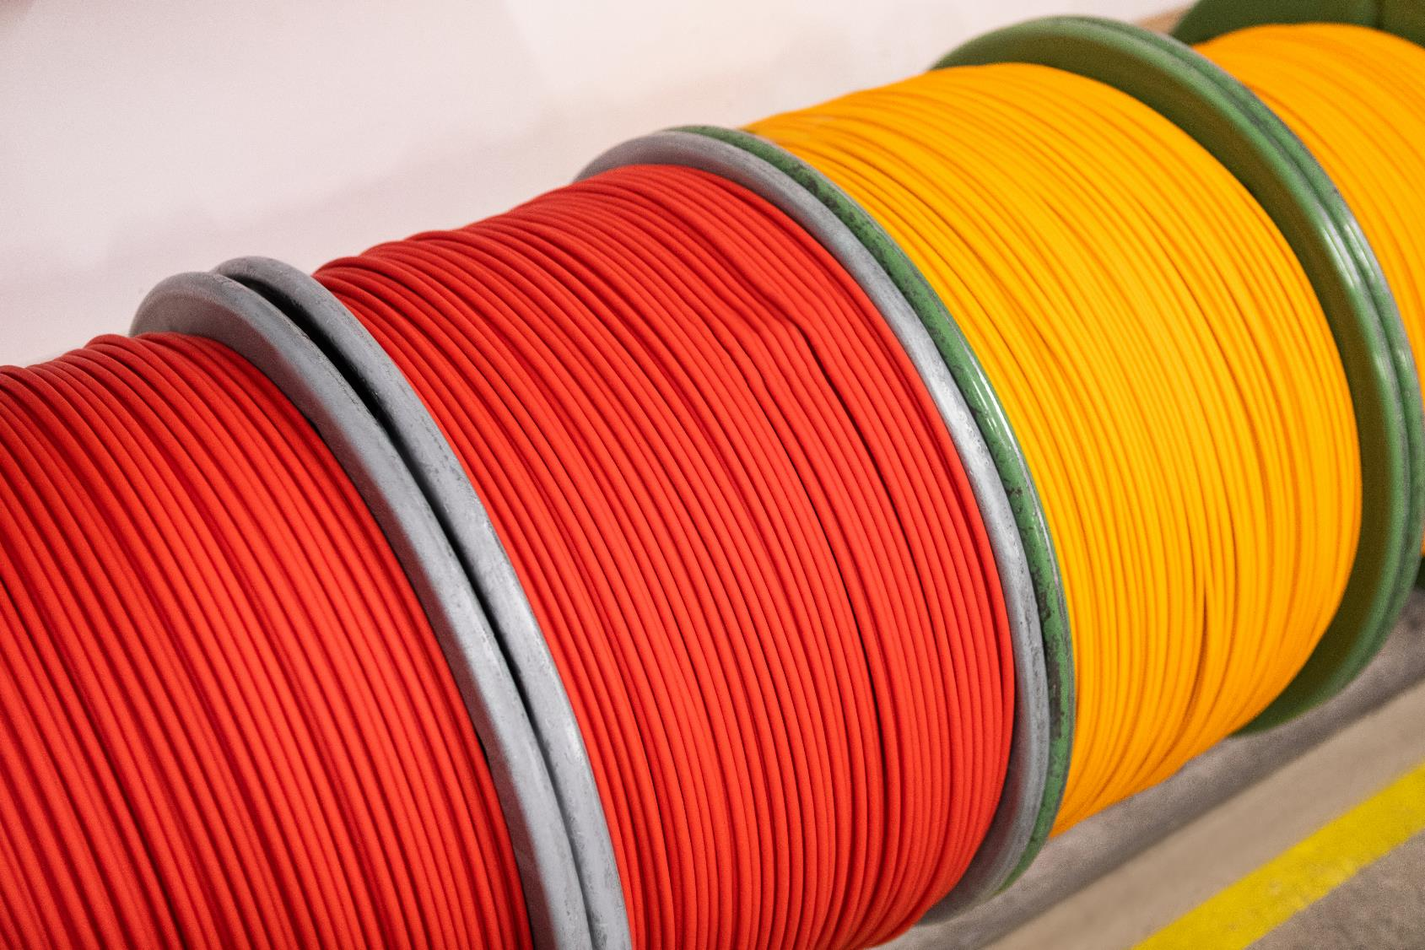
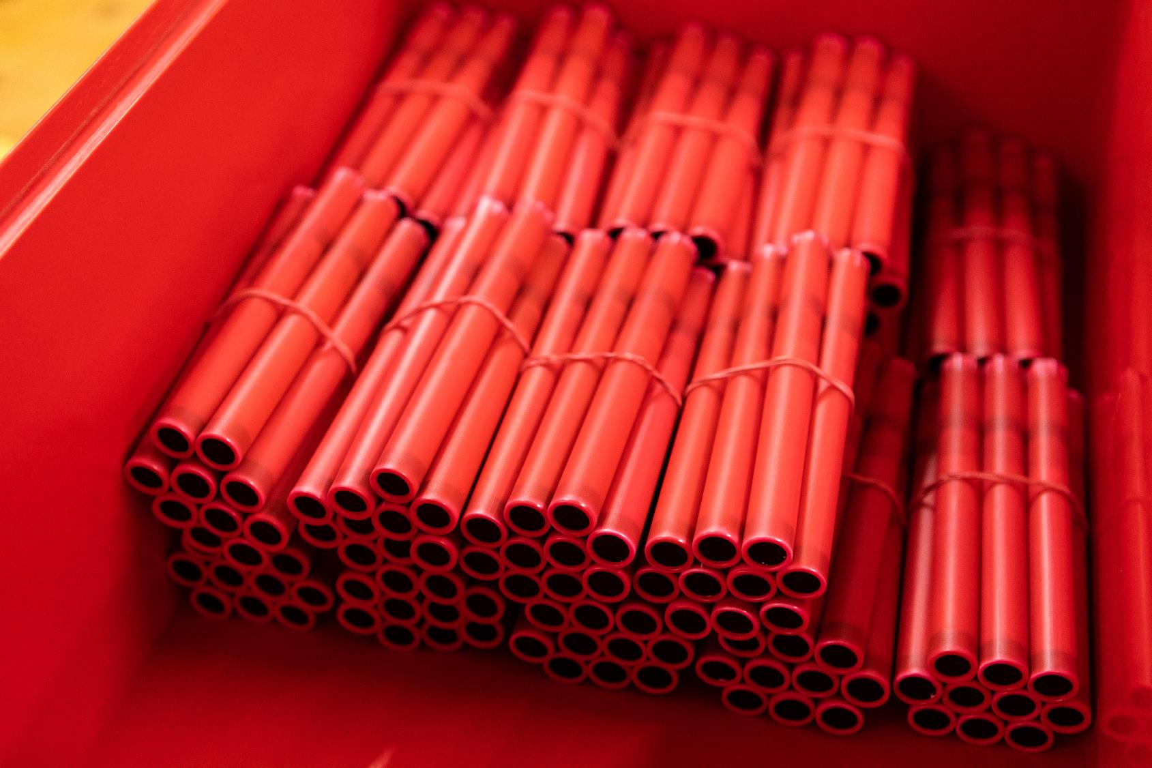
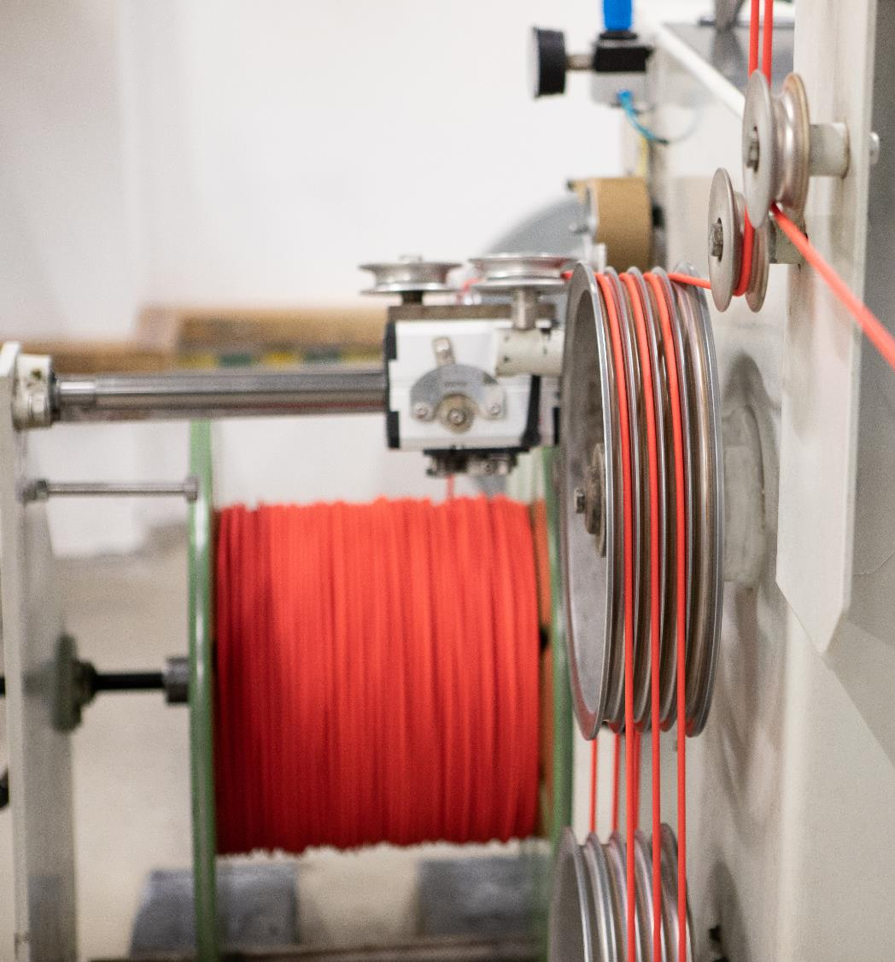
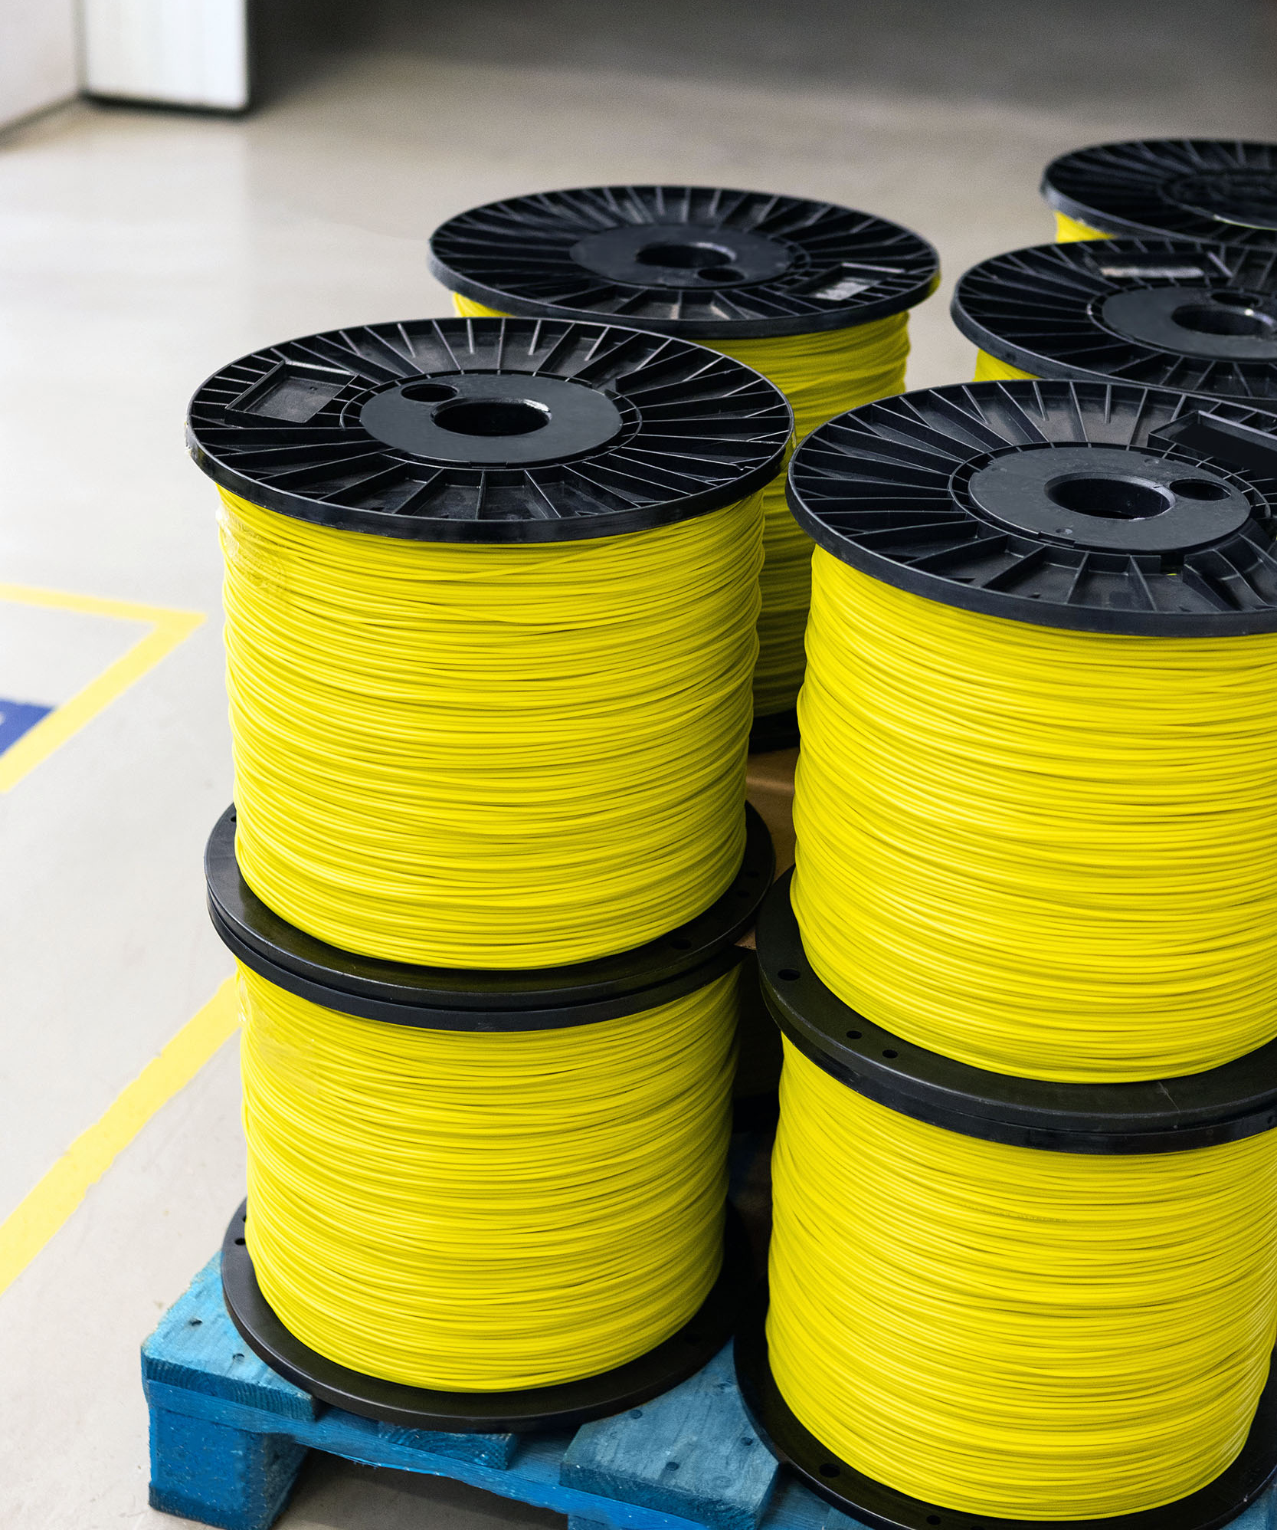
INITIATING SYSTEMS
ERGONIC-II electronic initiating system
programmable delays in the range of 0-20000 ms with an interval of 1 ms
ability to program and detonate up to 1,000 detonators per logger/blaster
possibility to combine logger/blaster sets in order to increase the number of set-off detonators
remote (wireless) ignition of detonators
NOVELTY
OTHER PRODUCTS
Detonating cord – NITROCORD
Rock - for use in open-pit and underground non-coal mining, as well as for demolition and engineering works.
Methane - for use in mining plants in conditions of threat of methane or coal dust explosion and when conducting blasting works.
Shock tube – NITROTUBE
Intended for production of non-electric detonators, and for application in blasting technology to extend the blasting line when using non-electric detonators.
Booster cap
Immediate, millisecond delay, half-second delay, deci-second delay
Explosive boosters - NITROBOOSTER 10M
Cord boosters - NITROCORD 20, 40, 80 Booster
NITROCONNECTOR
NITROBUNCH cord set

Slide 15
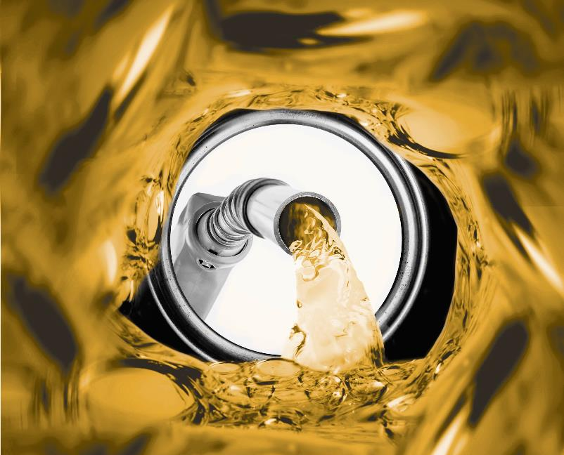
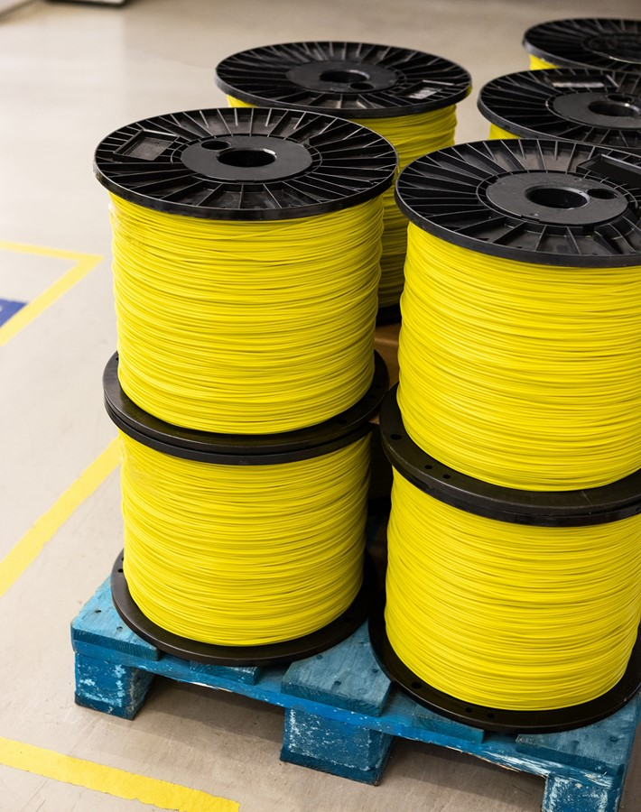

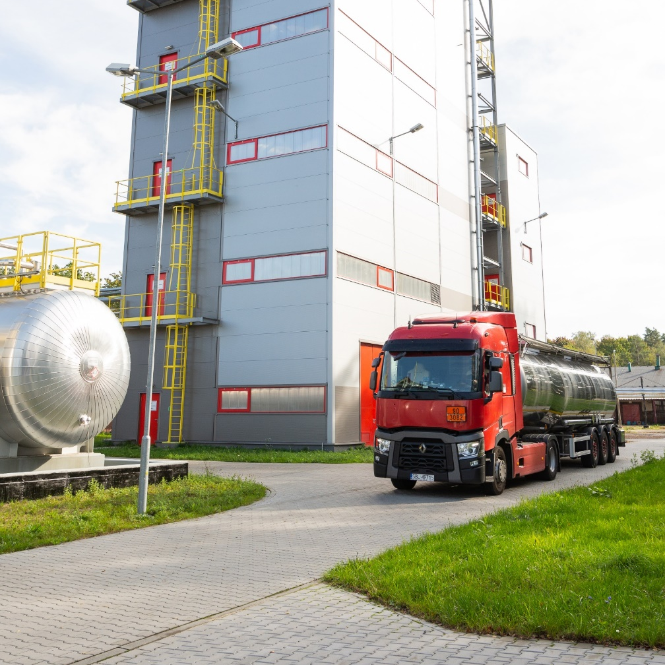
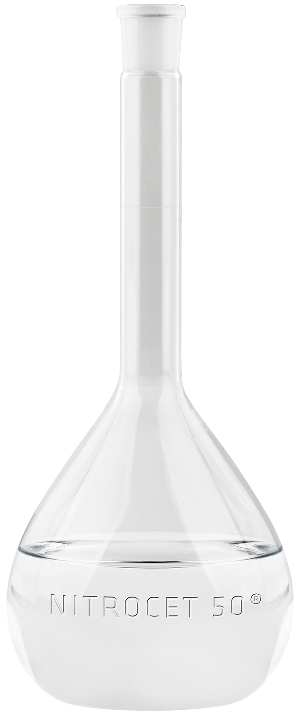
OTHER PRODUCTS
NITROCET 50®
NITROCET 50® - 2-ethylhexyl nitrate (2-EHN) is used as a diesel additive to increase the cetane number.
Detonating cord – NITROCORD
Rock - for use in open-pit and underground non-coal mining, as well as for demolition and engineering works.
Methane - for use in mining plants in conditions of threat of methane or coal dust explosion and when conducting blasting works.
Shock tube – NITROTUBE
Intended for production of non-electric detonators, and for application in blasting technology to extend the blasting line when using non-electric detonators.
Booster cap
Immediate, millisecond delay, half-second delay, deci-second delay
DIESEL
FUEL ADDITIVES
Explosive boosters - NITROBOOSTER 10M
Cord boosters - NITROCORD 20, 40, 80 Booster
NITROCONNECTOR
NITROBUNCH cord set

Slide 16
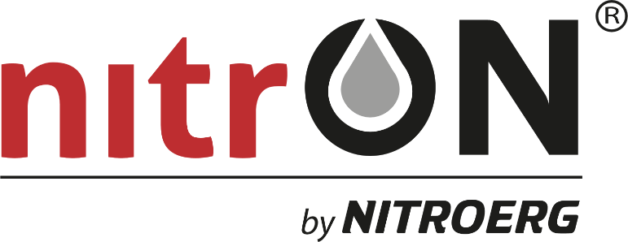



DIESEL
FUEL ADDITIVES
NOVELTY
NITROCET 50®
NITROCET 50® - 2-ethylhexyl nitrate (2-EHN) is used as a diesel additive to increase the cetane number.
Benefits of using NITROCET 50®:
MARKET BENEFITS:
enables production of high quality diesel oils recommended by engine manufacturers,
makes it possible to extend the product portfolio with special fuels - diesel premium.
TECHNICAL BENEFITS:
ensures faster ignition when the engine is cold,
has a positive effect on engine power,
positively impacts the efficiency of diesel fuel combustion,
preserves the engine and keeps it running smoothly at lower pressures.
ENVIRONMENTAL BENEFITS:
reduces toxic exhaust emissions (such as NOx, CO) and noise emissions,
eliminates carbon deposits on injector nozzles.

Slide 17


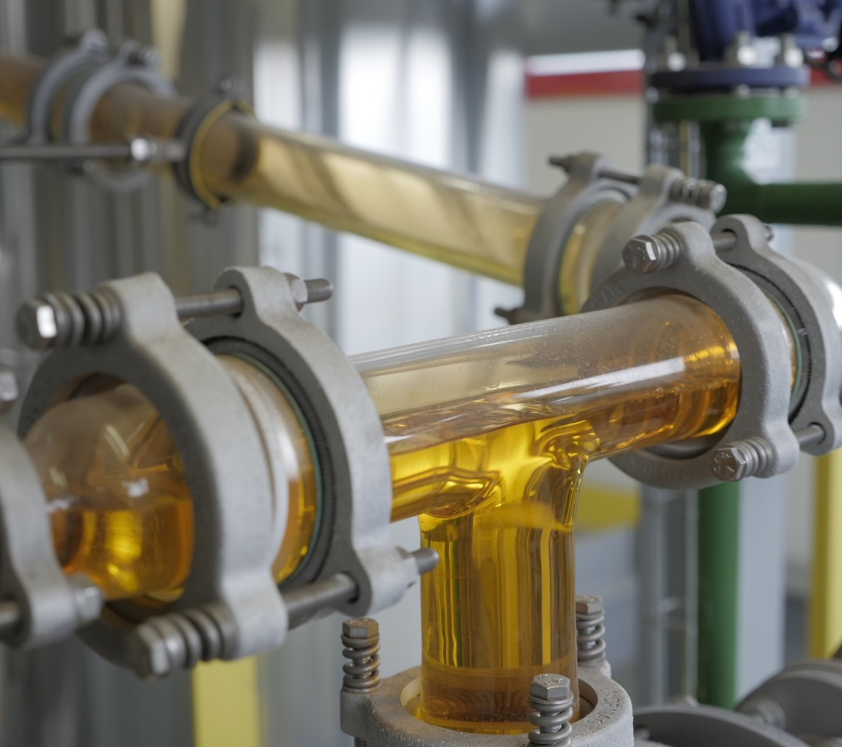



NITROCET 50®
NASZE MOŻLIWOŚCI PRODUKCYJNE
NOVELTY
NITROCET 50® - 2-ethylhexyl nitrate (2-EHN) is used as a diesel additive to increase the cetane number.
The nitrON package is an innovative, multifunctional cetane-detergent package with properties of a diesel oil combustion process modifier in compression ignition engines used in machines in areas such as mining, railway transport or agriculture.
Benefits of using NITROCET 50®:
MARKET BENEFITS:
enables production of high quality diesel oils recommended by engine manufacturers,
makes it possible to extend the product portfolio with special fuels - diesel premium.
nitrON comprehensively affects the dynamics of the fuel combustion process through:
improvement of fuel ignition properties,
improved engine starting regardless of the ambient temperature,
increasing the efficiency of the combustion process,
increased service life of engine and fuel system components,
prevention of injector coking phenomenon,
prevention of corrosion,
reducing engine noise.
TECHNICAL BENEFITS:
ensures faster ignition when the engine is cold,
has a positive effect on engine power,
positively impacts the efficiency of diesel fuel combustion,
preserves the engine and keeps it running smoothly at lower pressures.
Studies conducted show that nitrON provides up to:
12%
10%
10%
15%
16%
5%
ENVIRONMENTAL BENEFITS:
reduces toxic exhaust emissions (such as NOx, CO) and noise emissions,
eliminates carbon deposits on injector nozzles.
Reduced fuel consumption
Reduced CO₂ emission
Reduced CO emission
Reduced NO_{x} emission
Reduced HC emission
Reduced PM emission
relative to a reference fuel without nitrON.

Slide 18


NOVELTY
The nitrON package is an innovative, multifunctional cetane-detergent package with properties of a diesel oil combustion process modifier in compression ignition engines used in machines in areas such as mining, railway transport or agriculture.
DIRECTIONS OF SALES DEVELOPMENT
OUR PRODUCTION CAPABILITIES
Emulsion explosives:
Dynamites:
30 000 tonnes
Detonating cords:
18 000 tonnes
13 000 km
Detonators:
Fuel additives:
40 million pieces
30 000 tonnes
Shock tube:
150 000 km
nitrON comprehensively affects the dynamics of the fuel combustion process through:
improvement of fuel ignition properties,
improved engine starting regardless of the ambient temperature,
increasing the efficiency of the combustion process,
increased service life of engine and fuel system components,
prevention of injector coking phenomenon,
prevention of corrosion,
reducing engine noise.
Studies conducted show that nitrON provides up to:
10%
10%
10%
15%
16%
5%
Reduced fuel consumption
Reduced CO₂ emission
Reduced CO emission
Reduced NO_{x} emission
Reduced HC emission
Reduced PM emission
relative to a reference fuel without nitrON.

Slide 19




OUR PRODUCTION CAPABILITIES
Emulsion explosives:
Dynamites:
30 000 ton
Detonating cords:
18 000 ton
13 000 km
Detonators:
Fuel additives:
40 mln sztuk
30 000 ton
Shock tube:
150 000 km
SALES STRUCTURE
DIRECTIONS OF SALES DEVELOPMENT
Production diversification – stable and safe growth
Sales – 40 countries

Slide 20



DIRECTIONS OF SALES DEVELOPMENT
BLASTING SERVICES
SALES STRUCTURE
65%
EXPORT SALES
45%
EXPLOSIVES
20%
INITIATING SYSTEMS
Sales structure MARKETS
Sales structure PRODUCTS
35%
DOMESTIC SALES
35%
NITROCET 50®
Production diversification – stable and safe growth
Sales – 40 countries

Slide 21
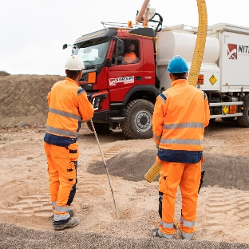
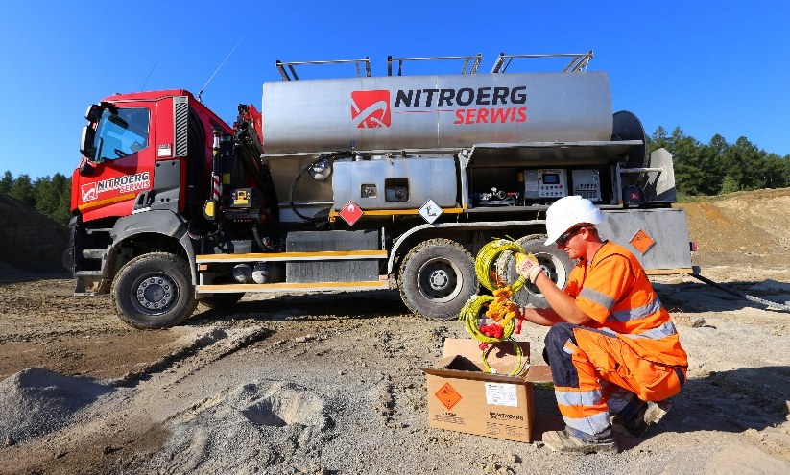

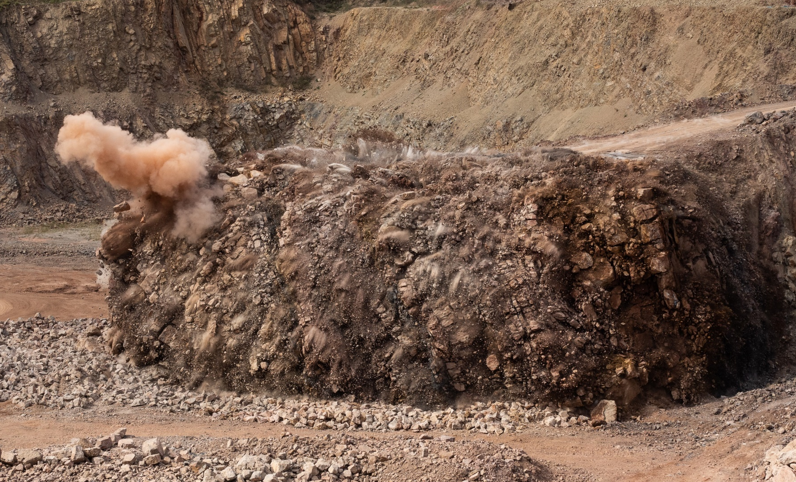

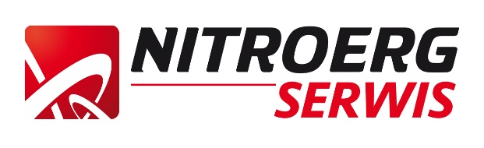
SALES STRUCTURE
BLASTING SERVICES
65%
EXPORT SALES
45%
EXPLOSIVES
20%
INITIATING SYSTEMS
NITROERG SERWIS has been providing comprehensive drilling and blasting services for more than 20 years.
Sales structure MARKETS
Sales structure PRODUCTS
It is also a representative and distributor of NITROERG S.A. blasting agents on the open pit market and in the area of civil work using explosives.
35%
DOMESTIC SALES
35%
NITROCET 50®

Slide 22
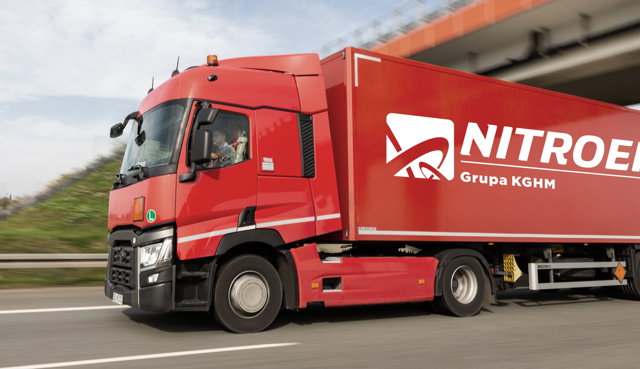

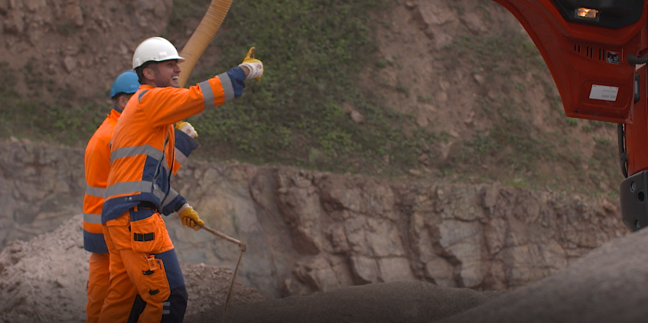



TRANSPORT SERVICES
BLASTING SERVICES
NITROERG SERWIS has been providing comprehensive drilling and blasting services for more than 20 years.
NITROERG SERWIS has extended operating and storage facilities in the Świętokrzyskie and Lower Silesia regions. This guarantees reliability, quality and timeliness of deliveries and services.
WROCŁAW
WILKÓW
KIELCE
It is also a representative and distributor of NITROERG S.A. blasting agents on the open pit market and in the area of civil work using explosives.
The company also uses NITROERG S.A. warehouses located in Bieruń and Krupski Młyn, which gives it the opportunity to operate in the Silesian, Małopolska and Opole areas.
KRUPSKI MŁYN
MORAWICA
KATOWICE
BIERUŃ

Slide 23

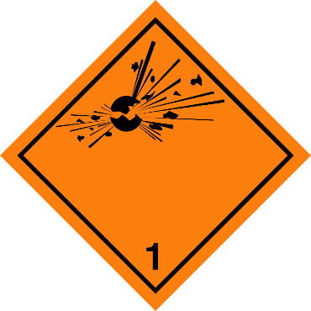




BLASTING SERVICES
QUALITY
TRANSPORT SERVICES
NITROERG SERWIS has extended operating and storage facilities in the Świętokrzyskie and Lower Silesia regions. This guarantees reliability, quality and timeliness of deliveries and services.
Proper product logistics is one of the cornerstones of our business.
WROCŁAW
WILKÓW
KIELCE
We have our own professional vehicle fleet, which ensures safe transportation of products and timely delivery.
KRUPSKI MŁYN
The company also uses NITROERG S.A. warehouses located in Bieruń and Krupski Młyn, which gives it the opportunity to operate in the Silesian, Małopolska and Opole areas.
MORAWICA
KATOWICE
We specialize in transporting dangerous goods included in class one of the international ADR convention.
BIERUŃ

Slide 24

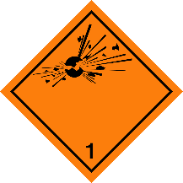






TRANSPORT SERVICES
COOPERATION
QUALITY
Właściwa logistyka wyrobów to jeden z fundamentów naszej działalności.
Quality, occupational health and safety and concern for the environment are values that guide us in our daily activities.
Our own quality control laboratory,
production execution based on applied ISO 9001:2015 and ISO 14001:2015 procedures
and ongoing quality improvement programs
allow us to manufacture products of the
highest standards.
Dysponujemy własną, profesjonalną flotą samochodową, która zapewnia bezpieczny transport produktów i terminową dostawę.
Specjalizujemy się w przewozie ładunków niebezpiecznych ujętych w klasie pierwszej międzynarodowej konwencji ADR.
Within the scope of our certificates we are supervised by auditors of TÜV Rheinland InterCert Kft, as well as the Central Mining Institute.

Slide 25
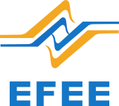




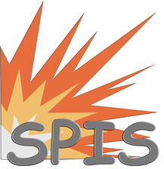




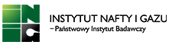









QUALITY
RESPONSIBLE BUSINESS
COOPERATION
For many years, NITROERG has been taking action and committing resources to initiatives in the area of responsible business.
We are active in organizations of explosives manufacturers.
We also cooperate with technical universities and research institutes
Jakość, bezpieczeństwo i higiena pracy oraz troska o środowisko naturalne to wartości, którymi kierujemy się w naszej codziennej działalności.
Własne laboratorium kontroli jakości, realizacja produkcji w oparciu o stosowane procedury ISO 9001:2015 oraz ISO 14001:2015 i prowadzone programy poprawy jakości pozwalają na wytwarzanie produktów o najwyższych standardach.
W ramach posiadanych certyfikatów jesteśmy nadzorowani przez auditorów TÜV Rheinland InterCert Kft.

Slide 26

COOPERATION
RESPONSIBLE BUSINESS
For many years, NITROERG has been taking action and committing resources to initiatives in the area of responsible business.
We are active in organizations of explosives manufacturers.
We also cooperate with technical universities and research institutes

Slide 27







RESPONSIBLE BUSINESS
EXPERIENCE
Our history dates back to 1871
PROFESSIONALISM
We are proud of our qualified team of over 1000 employees
CREDIBILITY
We operate within the KGHM Polska Miedź S.A. Group
TAILOR-MADE OFFER
We have 4 main areas of activity
CUSTOMER TRUST
We sell our products in more than 40 countries
For many years, NITROERG has been taking action and committing resources to initiatives in the area of responsible business.

Slide 28












EXPERIENCE
Our history dates back to 1871
NITROERG S.A.
PROFESSIONALISM
Plac Alfreda Nobla 1
43-150 Bieruń Poland
+48 32 466 19 00
We are proud of our qualified team of over 1000 employees
+48 32 466 13 57
nitroerg@nitroerg.pl
CREDIBILITY
Second business location
We operate within the KGHM Polska Miedź S.A. Group
ul. Zawadzkiego 1
42-693 Krupski Młyn Poland
+48 32 466 21 03
+48 32 466 21 00
TAILOR-MADE OFFER
We have 4 main areas of activity
www.nitroerg.pl
Facebook/Nitroerg
CUSTOMER TRUST
We sell our products in more than 40 countries
YouTube/NITROERG S.A.

